Slide 1
CAD/CAM

Slide 2
Module outline
Module learning outcomes:
select and apply appropriate techniques of 2D and 3D geometric modelling including parametric curves;
analyse the methods of information storage and transfer in CAD/CAM/CIM systems, and determine how to incorporate CAD technologies into different aspects of the design/manufacture process;
select and evaluate appropriate CNC and part programming techniques;
select and evaluate appropriate rapid prototyping techniques;
construct 2D and 3D models of a component, and suitable CNC programs for its manufacture;
acquire experience in appropriate CAD/CAM software.
Written Examination 50 Marks - Semester 1 Written Exam
Paper 1: 1.5hr paper - Written Questions (50 Marks)
Continuous Assessment 50 Marks
Project - A suitable CAD/CAM project. (50 Marks)

Slide 3
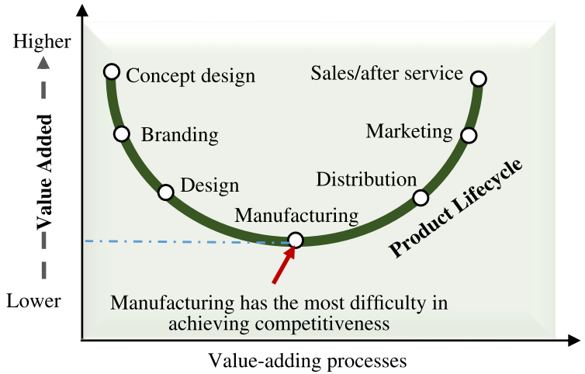
Scope of CAD/CAM
Fig. Value-added chain smile curve [2]

Slide 4
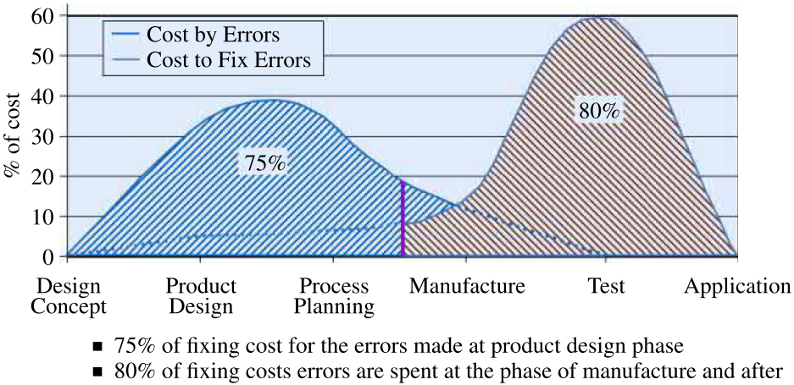
Scope of CAD/CAM
Fig. Relative costs to ﬁx errors at different phases of product lifecycle[2]

Slide 5
Scope of CAD/CAM
Fig.1 CAD/CAM disciplines [1]

Slide 6
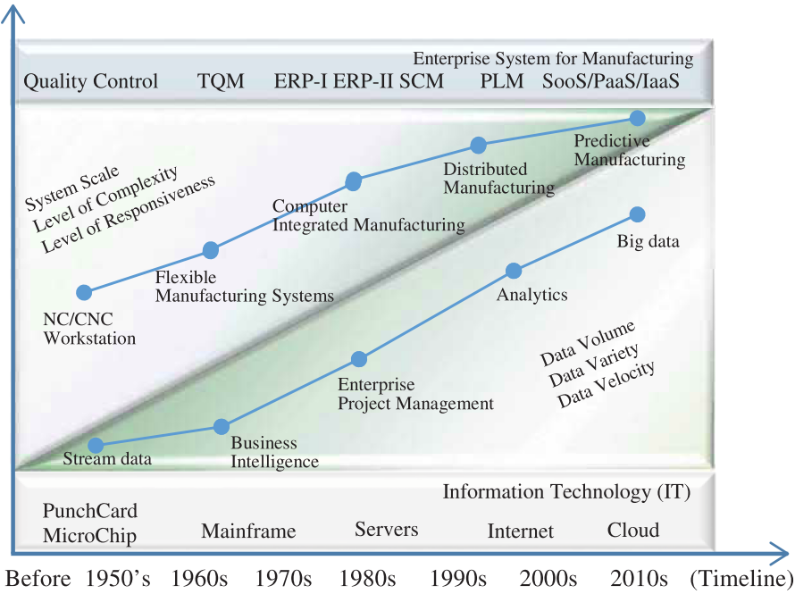
Scope of CAD/CAM
Fig.1 Evolution of computer aided technologies in manufacturing [2]

Slide 7
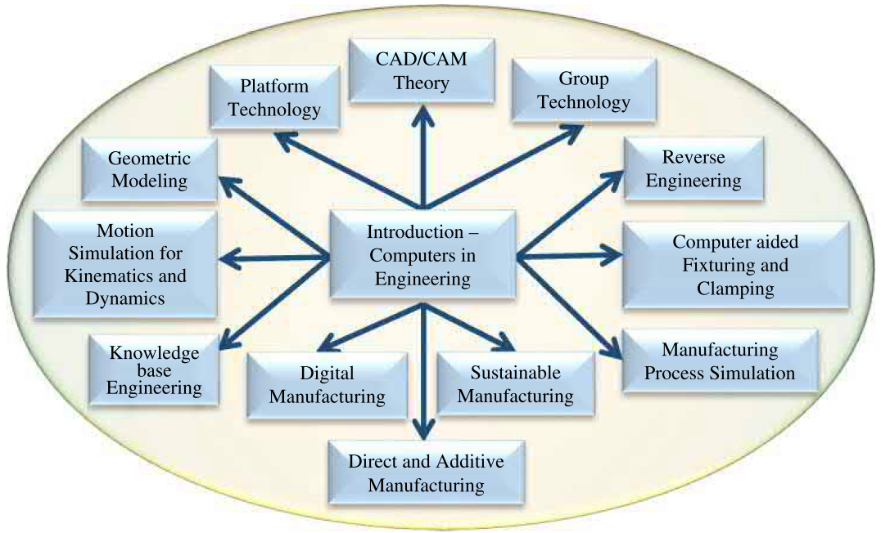
Scope of CAD/CAM
Fig. Scope of the CAD/CAM[2]

Slide 8
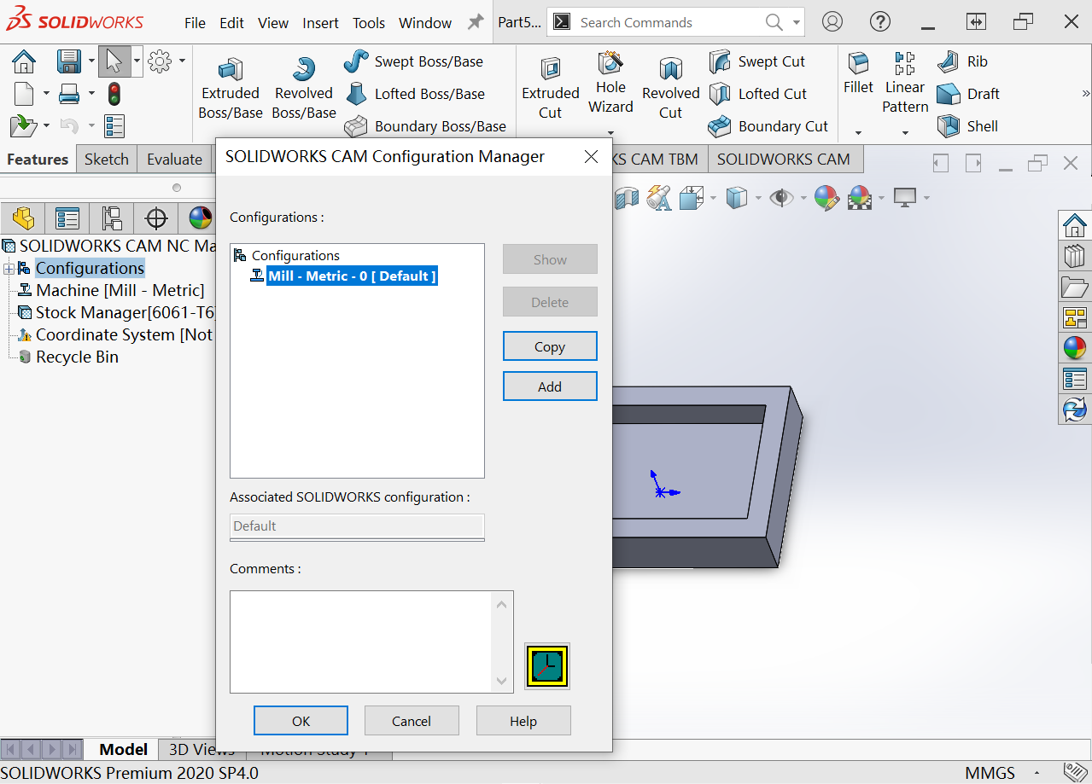
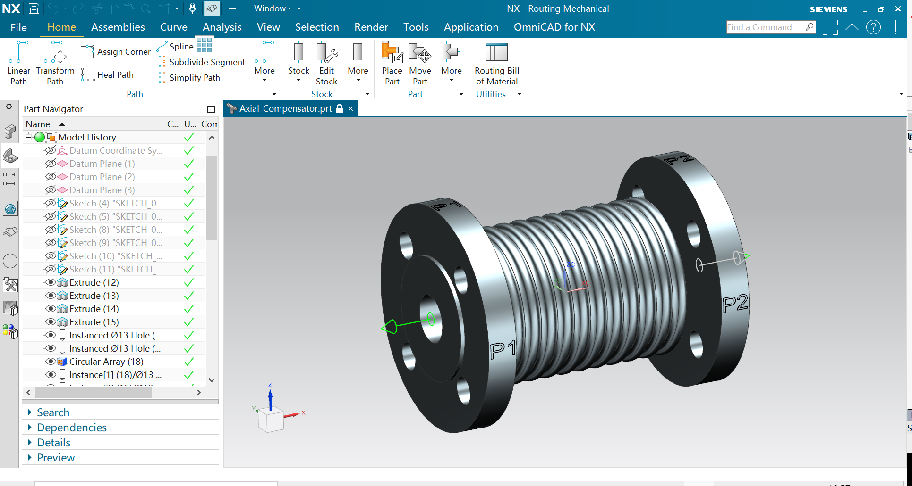
CAD/CAM system
Today, almost all the CAD/CAM software systems are interactive. To use this kind of system well, one, as a designer or user, should know of how these systems work and how to set or get information with CAD/CAM system through GUI(Graphics User Interface)
Fig.2 GUI of Solidworks and Siemens NX

Slide 9
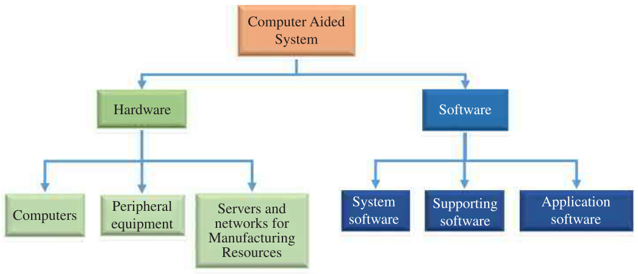
CAD/CAM system
Fig. Architecture of computer aided systems[2]

Slide 10
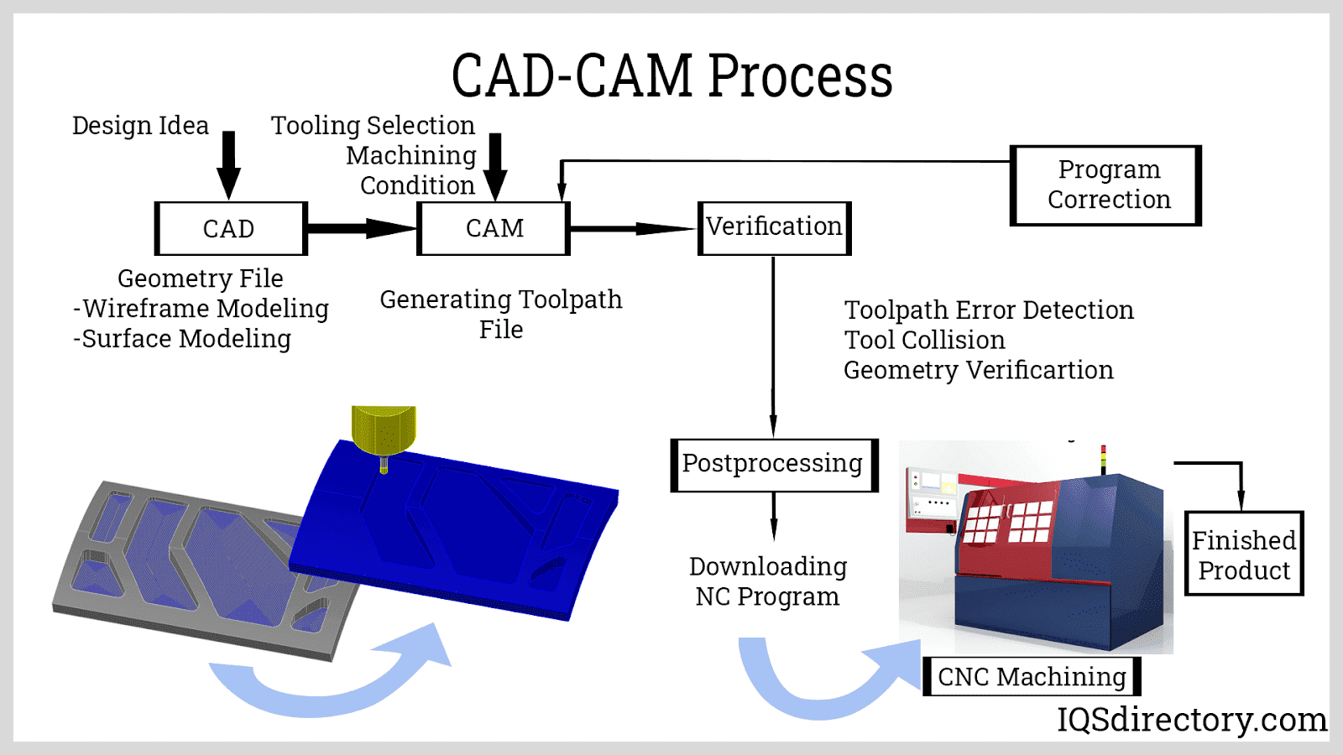
Fig.3 CAD/CAM Process

Slide 11
CAD

Slide 12
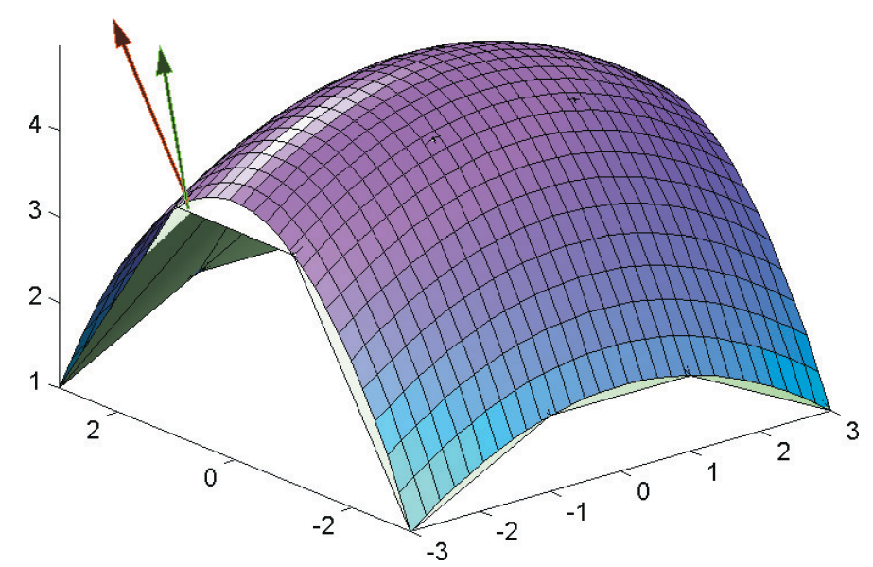
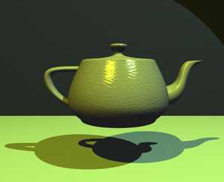
Introduction to computer graphics
Computer graphics focuses mainly on displays of any digital image by a computer.
There are bunch of hardware and software developed for fast and correct displays of graphics on terminals.
The core techniques of computer graphics are based on geometry, optics, physics, and perception.
Fig. Examples for computer graphics techniques

Slide 13
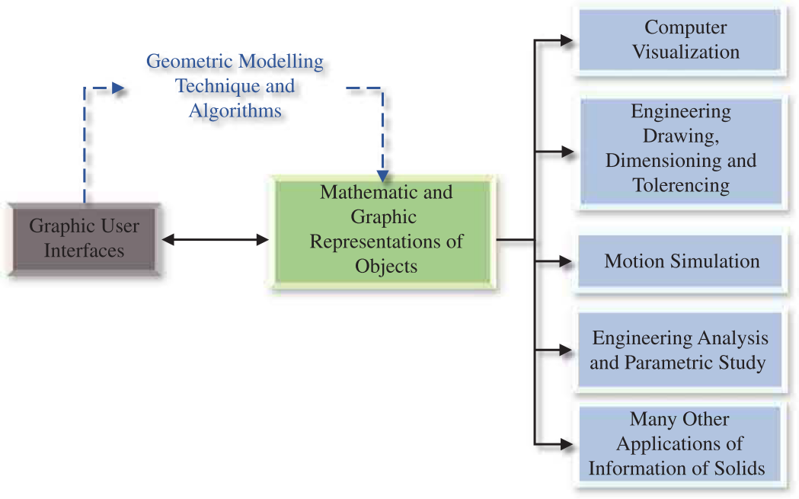
Role of geometric modelling in CAD
Fig. Role of geometric modelling in CAD

Slide 14
Coordinate system

Slide 15
Three types of coordinate system
Coordinate systems are the most important concept in a CAD system. They are used to input, store, and display geometric model. There are three kinds of coordinate systems,
Model coordinate system (MCS)
World coordinate system (WCS)
Screen coordinate system (SCS)

Slide 16
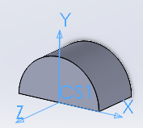
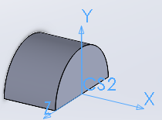
Model Coordinate System (MCS)
MCS is a 3D Cartesian coordinate system used by most of CAD softwares to perform internal geometrical data operations, such as record, storage and calculation.
MCS is the only coordinate system CAD software can identify. Even users define another type of coordinate system during the process of creating models, the model will still be convert to data under MCS to store.
Sometime MCS is also called Absolute Coordinate System(ACS).
Fig. Model coordinate system

Slide 17
World Coordinate System(WCS)
A modelling processing of a 3D body is usually a result of combining many steps of creating some simple structure bodies. WCS is an user defined local coordinate system, with which user can generate some basic structures easily.
WCS has different appearances in different CAD systems. One of the most useful one is a sketch plane.
As mentioned, whatever was chosen to be a coordinate system , the stored data should be represented with MCS. To satisfy this requirement, a homogenous transform matrix will play an very important role. which is usually a 4x4 matrix.

Slide 18
World Coordinate System(WCS)
Given a vector under WCS, , and let is the stored point represented with MCS. Supposing T is the transformation matrix, we have

Slide 19
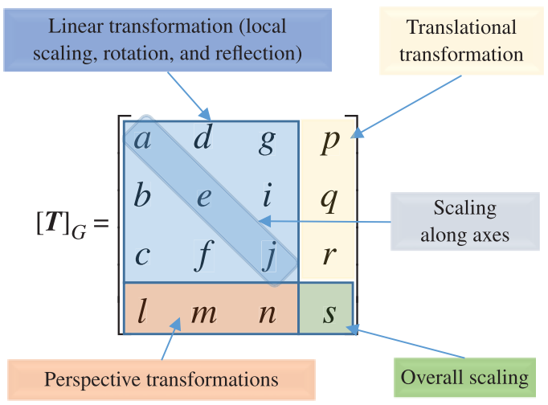
Homogenous transformation matrix
Since we still need consider translation and project operation as well. The matrix to finish all the transformations from WCS to MCS looks like.
Fig. Generalized homogeneous matrix[2]

Slide 20
Homogenous transformation matrix
Let
The above matrix become
T is to transform coordinate components, o means origin point shifting,
p is projective vector, s means projective shifting

Slide 21
Homogenous transformation
Actually, for any point under WCS should be transformed to MCS, the final forms looks like

Slide 22
Some useful HT matrices
Matrix without perspective involved

Slide 23
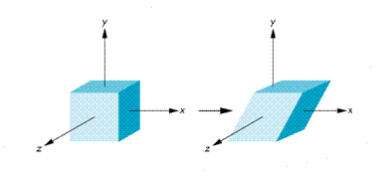
Some useful HT matrices
Matrix pure shearing involved
At the same time, T part of this matrix is symmetric. Which means t₂₁=t₁₂, t₃₁=t₁₃, t₃₂=t₂₃
https://jcsites.juniata.edu/faculty/rhodes/graphics/transforms.htm

Slide 24
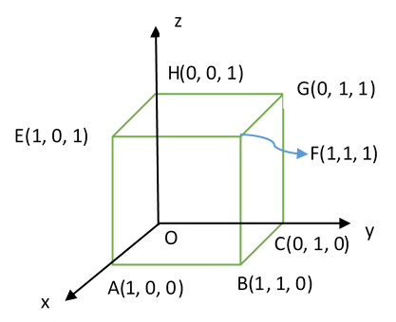
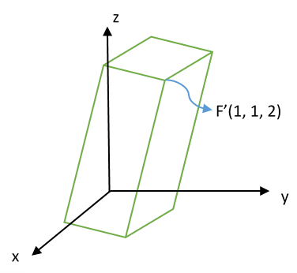
Example: Given a cube with length of edge 1 at the origin O, assume vertex O is fixed, and there is a homogenous transformation which shear vertex F(1,1,1) to F’(1,1,2). Find out the transformation matrix and the new positions of all vertices.
Fig.5 Body’s transformation

Slide 25
To vertex E, we have the linear equations after taking use of shearing transformation
The solution of homogenous transformation matrix is

Slide 26
Screen coordinate system (SCS)
The coordinate system of screen is a 2D Cartesian coordinate system, which origin (0,0) locates at left-upper corner of the screen. The scale of SCS usually depends on the resolution of screen. For example if the revolution of a screen is 1096x1024, which means the X axis extend to right of screen until scale of 1096, and the Y axis extend to bottom of screen until scale of 1024.
The SCS is mainly used to display correct images on screen device. So it is pixel related.
(0,0)
X
Y
Fig. Screen coordinate system

Slide 27
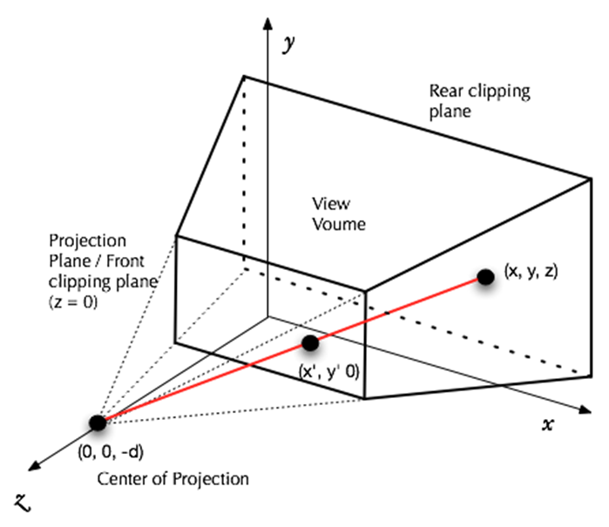
View Generation
The display screen is two-dimensional.
How to present 3D model on the screen.
the orthogonal projection.
Fig. overview of projection[1]
https://cs.lmu.edu/~ray/notes/graphicsintro/

Slide 28
Coordinate system
By default, in most of CAD software, the WCS and MCS are overlapped as you start up the main program.
Definitely, To display correct image of the cad model on screen, we still need some transformation operations to make it sense.
From the view of user, the inputted geometrical elements will firstly transform to uniforms under MCS, then through display converting package developed by CAD software provider, all 3D geometrical items will be shown on the 2D screen.

Slide 29
CAD data exchange and storage

Slide 30
CAD data exchange and storage
Graphic standards
There are various CAD software systems used in different fields. How people could share the same model among these systems? The answer is to share data obeying the same standard. The mainstream data standards are: IGES, GKS, STEP, STL, etc.
Fig. Data exchange between two systems

Slide 31
Data exchange standards
There is increasing application of CAD accompanied by a growth in product variety and the range of companies involved
component suppliers must often match their designs to many variants of different products
a large amount of component and product data must be exchanged
the simplest way is for both companies to used same CAD/CAM system and software revision number
however, it is more equitable for different CAD/CAM systems to accurately exchange the same data
too many individual inter-software translator programs would be required
need to convert the data into a neutral file format first
then translate the neutral format into the target system data structure
However, a neutral file format is not straightforward due to
different international CAD/CAM methods
different CAD representations:
2D draughting; wire frame geometry; surface/solid models
higher order curves → cubic polynomial conversion leads to loss of precision
Ongoing effort to define an internationally accepted standard

Slide 32
IGES(Initial Graphics Exchange Specification)
A standard for the structure and syntax of neutral file in ASCII, compressed ASCII or binary format
the ASCII format is: 80 character records/lines, terminated by semicolons, fields divided with commas
Start section:
– contains data such as the features of the originating system to assist the recipient in translating the file
Global section:
– contains 24 parameter fields which are necessary to translate the file
Directory section:
– contains 18 x 8-character fields on 2 lines as an entry for each entity; codes represent the entity type, subtype, and pointers to entity data in next section
Parameter Data Section:
– contains entity specific data such as coordinates, annotations, spline control points, pointers to directory entries, etc.
the first parameter for each entry identifies the entity type from which the meanings for remaining parameters are derived.
Termination Section:
– marks the end of the data file, contains subtotals of records for data transmission checks

Slide 33
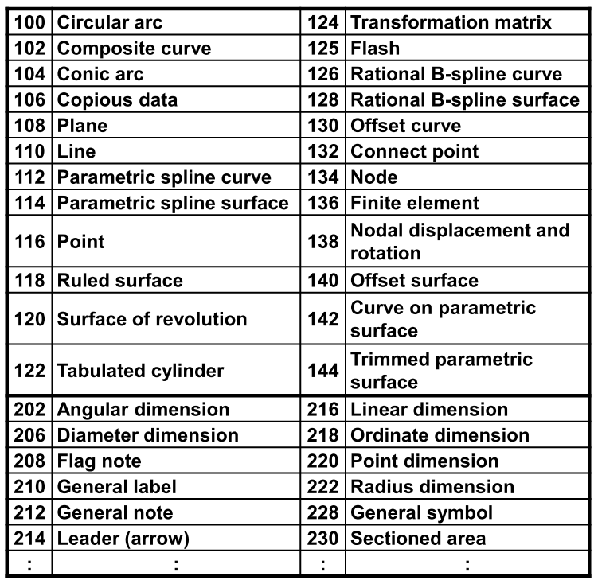
IGES data types
The global section consists of:
delimiter characters (1,2); sender’s identifier (3); filename (4); software ID (5); IGES processor version (6); number precision (7-11); receiver’s identifier (12); model space scale (13); units (14); unit name (15); maximum number of line thicknesses (16); maximum line thickness (17); time file generated (18); smallest distance (19); largest coordinate (20);
Each record line has an identifier in columns 73-80 used as a pointer for cross-referencing between sections
the first character indicates the section (S = Start, G = Global, D = Directory, P = Parameter, T = Termination)

Slide 34
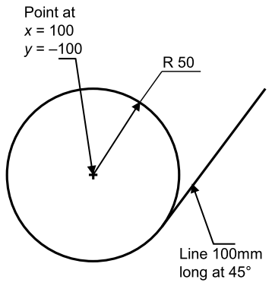
IGES example
EXAMPLE IGES FILE S0000001
1H,,1H;,,,9HMASTERCAM, 1H1,16,8,24,8,56,,1.,1,4HINCH,1,0.01, G0000001
13H850101.0100000,0.,100.,,,,; G0000002
116 1 1 1 1 0 00000000D0000001
116 0 3 1 D0000002
124 2 1 1 1 0 00000000D0000003
124 0 3 1 D0000004
100 3 1 1 1 3 00000000D0000005
100 0 3 1 D0000006
110 4 1 1 1 0 00000000D0000007
110 0 3 1 D0000008
116,100.,-100.,0.; 1P0000001
124,1.,0.,0.,0.,0.,1.,0.,0.,0.,0.,1.,0.; 3P0000002
100,0.,100.,-100.,-150.,-100.,150.,-99.99999; 5P0000003
110,135.3553,-135.3553,0.,206.066,-64.64465,0.; 7P0000004
S0000001G0000002D0000008P0000004 T0000001
• (116) point, (124) transformation matrix, (100) circular arc, (110) line
Note: Parameter entry for line (110) is x1, y1, z1, x2, y2, z2; for arc (100) is z,
x, y of centre, x, y of start point, x, y of end point; for point (116) is x, y, z.

Slide 35
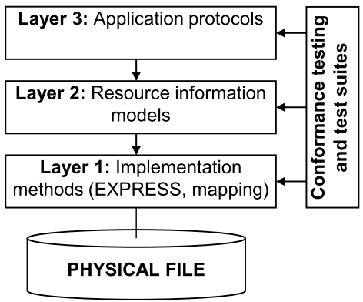
STEP(Standard for the Exchange of Product model data)
Uses a formal model for data exchange, described using an information modelling language called EXPRESS
STEP has a three layer architecture enabling definition of multiple application views and implementations:
techniques for implementing STEP, relations between EXPRESS language, model, and the physical file
resource information models to provide context independent information
description of geometry, topology, product structure
application protocols describing constrained subsets related to specific applications such as geometry, electrical product modelling, etc.

Slide 36
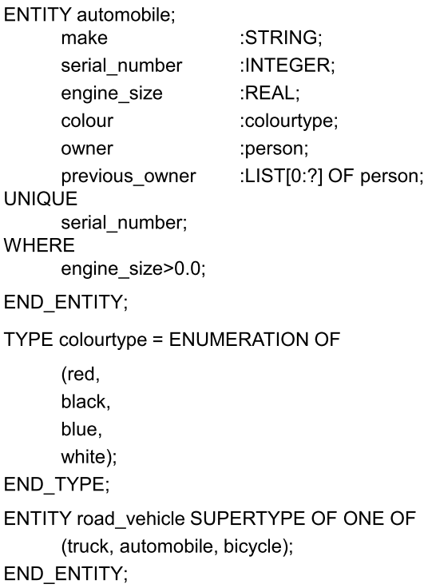
EXPRESS language
IGES defines the file format
STEP uses the EXPRESS language to map the data to the physical file
the EXPRESS language is used to define entities as a collection of attributes
– strings
– real/integer numbers
– logical/Boolean values
– references to other entities, etc.
collections of attributes may be:
– ordered: arrays, lists
– unordered: sets, bags
the collection of entity definitions, data types and associated constraints is a schema

Slide 37
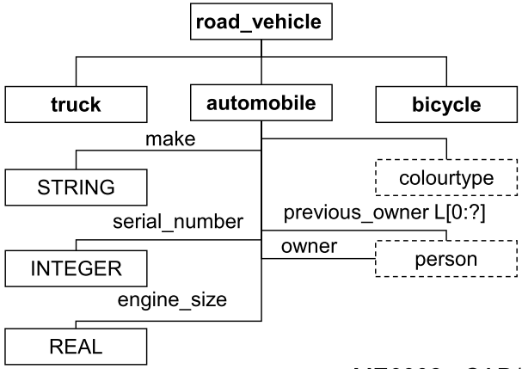
EXPRESS geometric entities
EXPRESS-G is a specific subset of EXPRESS used for graphical notation
– simpler definition of relationships between entities in a class hierarchy
– constraints cannot be specified
– other EXPRESS subsets developed
ENTITY point ;
x-coordinate : REAL ;
y-coordinate : REAL ;
z-coordinate : REAL ;
END_ENTITY ;
ENTITY circle ;
centre : point ;
radius : REAL ;
END_ENTITY ;
#15 = POINT (3.3,4.4,5.5) ;
#16 = POINT (6.6,7.7,8.8) ;
#17 = CIRCLE (#15, 5.0) ;

Slide 38
STEP standard
STEP is being developed incrementally as a series of separate standards (parts) divided into classes:
– Introductory (1-9)
• Part 1: Overview and general Principles
– Description Methods (11-19)
• Parts 11, 12: EXPRESS language
– Implementation Methods (21-29)
• describe how EXPRESS mapped to physical files and other storage mechanisms
– Conformance Testing Methodology and Framework (31-39)
• provide methods for testing implementations, and test suites
– Integrated Resources (41-99, 101-199)
• geometry and structure representation (41-99), and widely used applications such as draughting and FE (101-199)
– Application Protocols (210-299)
• implementation of STEP to specific industrial applications
– Abstract Test Suites (301-399)
• for each of the application protocols
– Application Interpreted Constructs (501-?)
• describe model entity constructs and specific modelling approaches

Slide 39
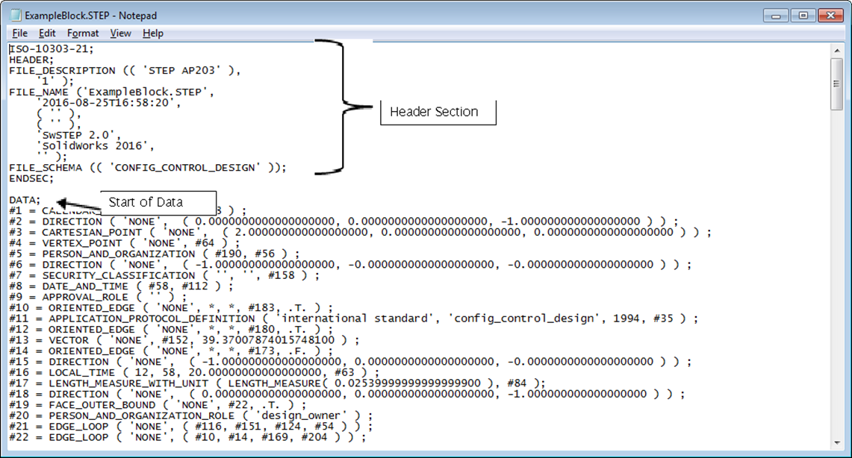
Example of a STEP file

Slide 40
Scope of STEP
Standard for the Exchange of Product Model Data ( STEP), officially the ISO standard 10303, Product Data Representation and Exchange, is a series of international standards with the goal of defining data across the full engineering and manufacturing life cycle.
The standard method of representing the information necessary for completely defining a product throughout its entire life, i.e., from the product conception to the end of useful life.
Standard methods for exchanging the data electronically between two different systems.

Slide 41
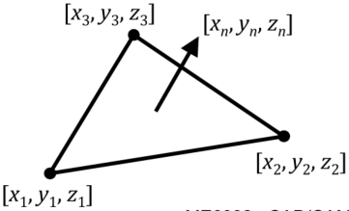
STL
STL is a generic file format that uses tessellated triangular tiles or facets to describe the surfaces of the object to be made, in a binary or an ASCII text file format
developed by 3D Systems, USA in 1987 (STereo Lithography, or Standard Tessellation Language), now public domain
each triangular facet is defined by 3 points at its vertices and a facet unit normal vector n, pointing outwards

Slide 42
STL ASCII text file format
The right-hand rule is used to determine the coordinate geometry
The normal vector is unit length and can be from any convenient part of the facet (a vertex or the facet centre)
the object is delimited by “solid <name>” and “end solid”
each facet is delimited by “facet normal” and ”end facet”
the three vertices are delimited by “outer loop” and “end loop”
The facets may be listed in the file any order (unsorted)
the vertices should be listed in counter-clockwise order (looking from the outside) as this makes the normal vector redundant using the right-hand rule; the starting vertex is arbitrary

Slide 43
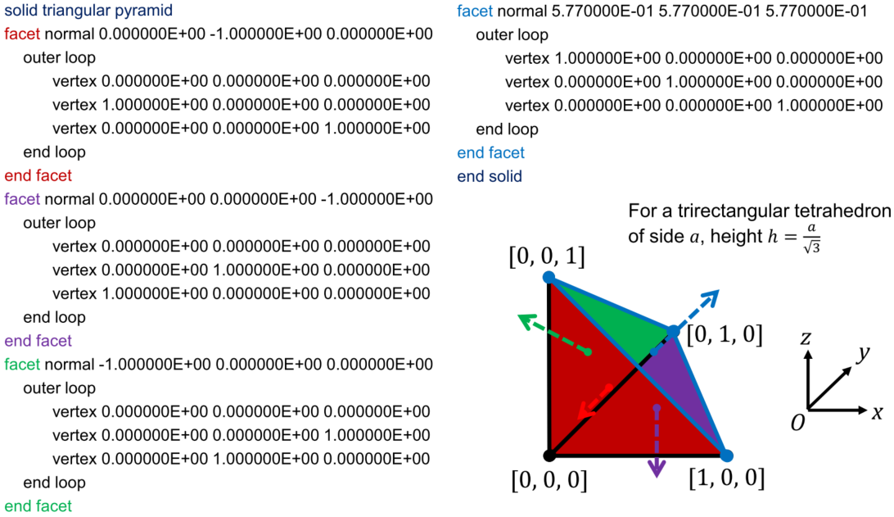
STL example ASCII text file

Slide 44
STL binary file format
an 80-byte ASCII header used to describe the part
a 4-byte (32-bit) unsigned integer giving the number of facets in the object
this gives a maximum of 4,294,967,295 facets in any STL object
A list of facet records, each 50 bytes long, as follows:
3 x 32-bit (4 byte) floating point numbers for the normal vector
3 x 32-bit (4 byte) floating point numbers for the first vertex
3 x 32-bit (4 byte) floating point numbers for the second vertex
3 x 32-bit (4 byte) floating point numbers for the third vertex
a 2-byte unsigned integer used for checking, usually set to 0
(32 bits: the 1 st bit is the sign, the next 8 bits are the exponent, the last 23 bits are the fraction)

Slide 45
Creating CAD models for STL
The CAD model must be a solid or fully enclosed surface
models created with surface modelling techniques (e.g. with Autodesk Alias Studio, or Rhino) to manipulate surface detail should be tested for geometric errors
SolidWorks models are solids that do not usually need testing
Curved surfaces are approximated by tessellated triangular facets, so the larger the triangles, the coarser the approximation
the minimum offset between the facet and the curved surface should be specified, this determines the number of facets
if the offset is less than the manufacturing tolerance (e.g. the thickness of a 3D printed layer) then it will have no significant effect on the precision of the final component

Slide 46
Exporting CAD data
Transferring 3D CAD models between different software packages can be challenging
– fortunately, most CAD packages will directly import files produced in most other packages
• If the file type is not supported, the data must be exported as a neutral format and then imported
– important information may be “lost in translation”
– this applies especially to non-geometric data in 3D models, such as material type
• Sometimes, the geometry could not be properly converted

Slide 47
Introduction to Geometric Modelling
Geometric modelling is a combination discipline with applied mathematics and computational geometry. In this discipline, people designed varied algorithms to describe all kinds of shapes by computers.
Building two or three dimensional models is crucial content of CAD & CAM.
When we were creating a geometric model of a mechanism using a CAD system, what we do is just map real or imaginary structure to a new algorithmic object. This process should be unique and complete. Otherwise, a designer will not be able to restore any of them from start to the end or vice versa. Furthermore, the model could not be manufactured.
This section will tell you what is the theoretical basis of geometric modelling.

Slide 48
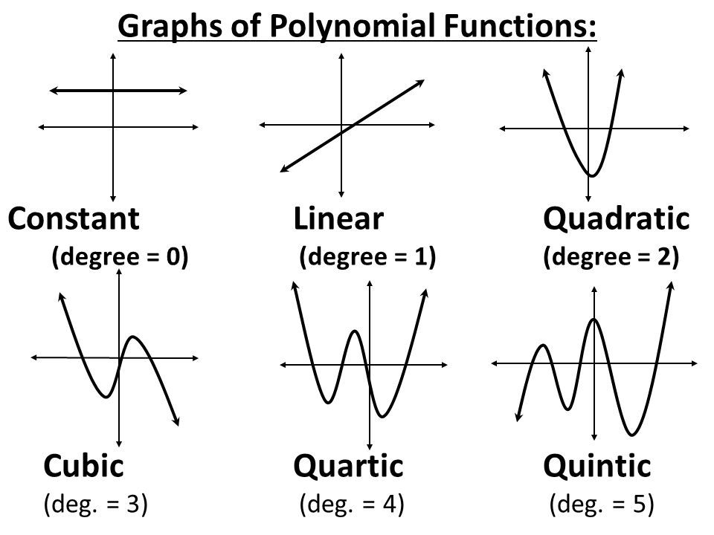
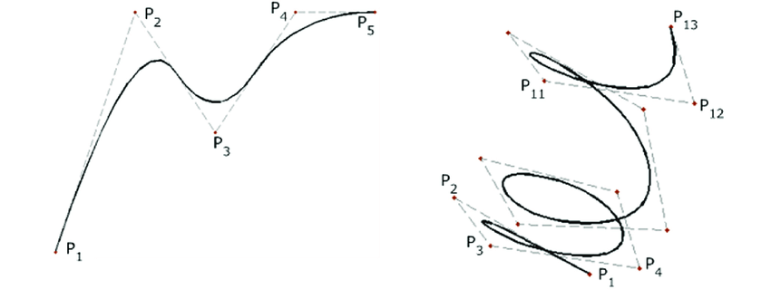
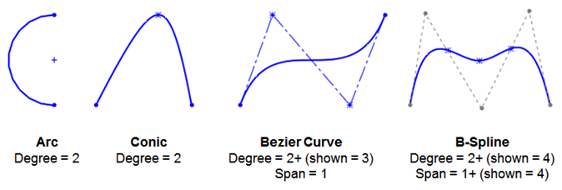
Geometry of curve
Representation of curves
Cubic polynomial curves
Bezier curves
Cubic spline curves
B-spline curves
NURBS
https://www.pinterest.com.au/pin/773915517188210154/
https://www.researchgate.net/figure/Example-of-NURBS-curve-a-2D-curve-with-five-control-points-and-a-complex-helix-drawn_fig13_284132180
https://www.design-engineering.com/master-splines-in-solidworks-%E2%80%93-part-1-132057/

Slide 49
Geometry of curve – Representation of curves
Issues in CAD of classical analytic curves
Uneven points
Numerical issue (infinite slope like…)
Multi-valued points
Coordinate system dependent
Solution
Interpolation (pass through all the points)
Approximation (the best fit instead of passing through all points)
Parametrize curve (time-varied trajectory of a moving point)
Composite (piecewise curve)
Ex.

Slide 50
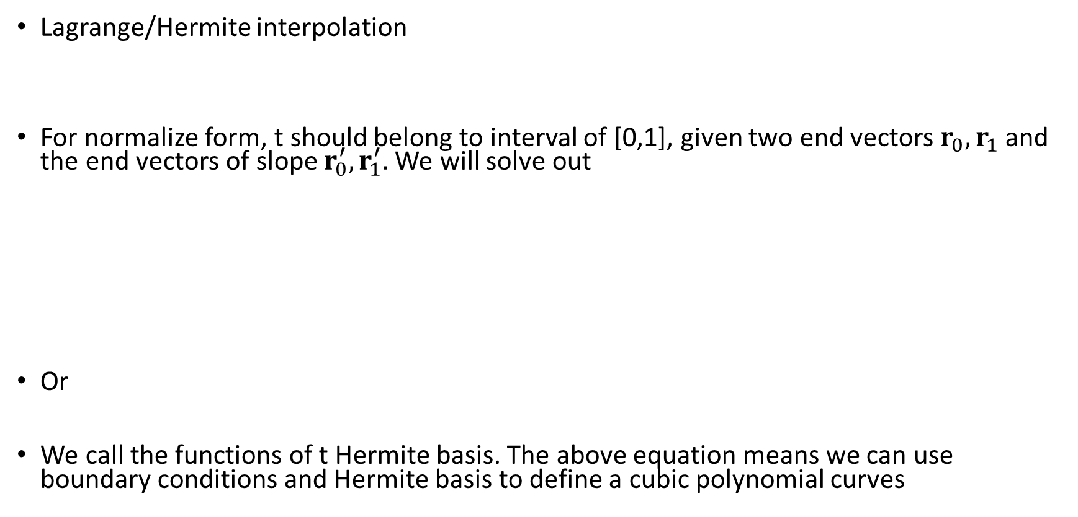
Geometry of curve – cubic polynomial curves
Lagrange/Hermite interpolation
For normalize form, t should belong to interval of [0,1], given two end vectors $r_{0},r_{1}$ and the end vectors of slope $r_{0}^{′},r_{1}^{′}.$We will solve out
Or
We call the functions of t Hermite basis. The above equation means we can use boundary conditions and Hermite basis to define a cubic polynomial curves

Slide 51
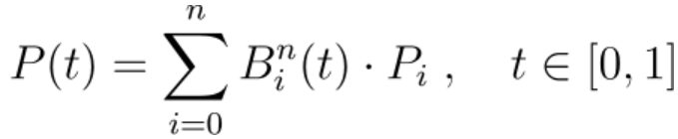
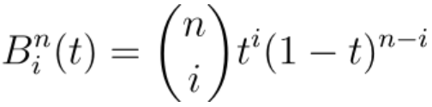
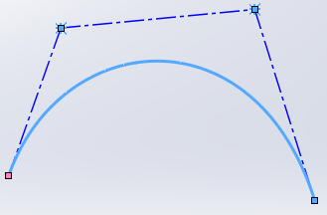
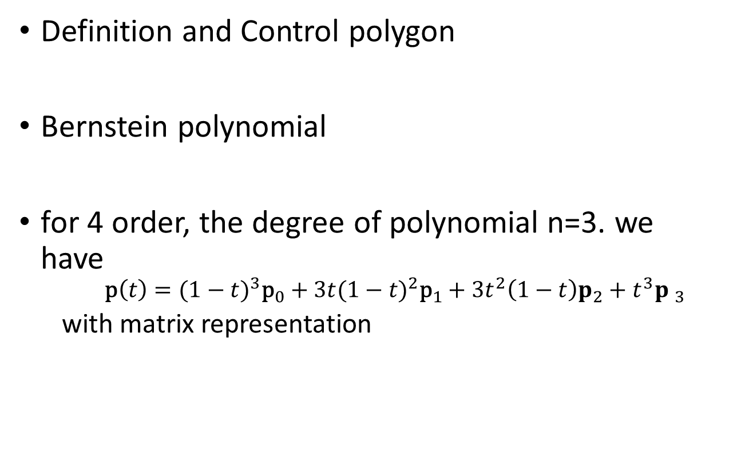
Geometry of curve – Bezier curves
Definition and Control polygon
Bernstein polynomial
for 4 order, the degree of polynomial n=3. we have
$${\text{p}\left(t\right)=(1−t)}^{3}{\text{p}}_{0}+{3t(1−t)}^{2}{\text{p}}_{1}+3t^{2}\left(1−t\right)p_{2}+t^{3}{p }_{3}$$
with matrix representation

Slide 52
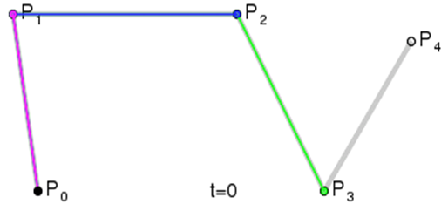
Geometry of curve – Bezier curves
Global control. Changing one of control points affects the shape of whole curve.
The degree of equation depends heavily on the number of control points, which means that the more control points you give, the less efficient it is to generate the curve.

Slide 53
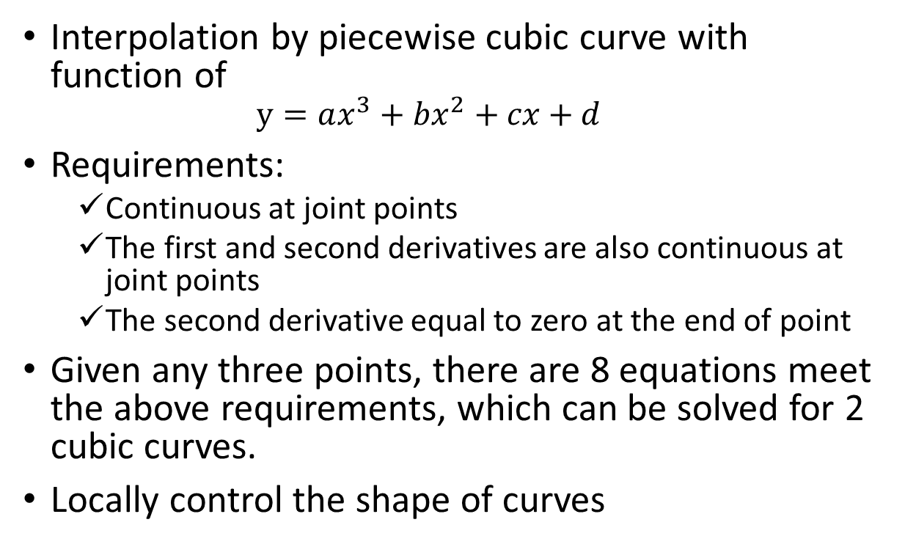
Geometry of curve – Cubic spline curves
Interpolation by piecewise cubic curve with function of
$$y=ax^{3}+bx^{2}+cx+d$$
Requirements:
Continuous at joint points
The first and second derivatives are also continuous at joint points
The second derivative equal to zero at the end of point
Given any three points, there are 8 equations meet the above requirements, which can be solved for 2 cubic curves.
Locally control the shape of curves

Slide 54
Geometry of curve – B-spline curves
B-spline shorted from Basis Spline, is a generalisation of Bezier curve. In other words, a Bezier is a special case of B-spline.
Separate curve degree from the number of given points, which means B-spline curve has the flexibility of choosing the degree of the curve irrespective of the number of control points.
B-splines can be of any degree, but the degrees 2 or 3 is the most useful in computer graphics.
A B-spline is a smoothly joined piecewise parametric polynomial curve
B-spline can be use as both interpolation and approximation.

Slide 55
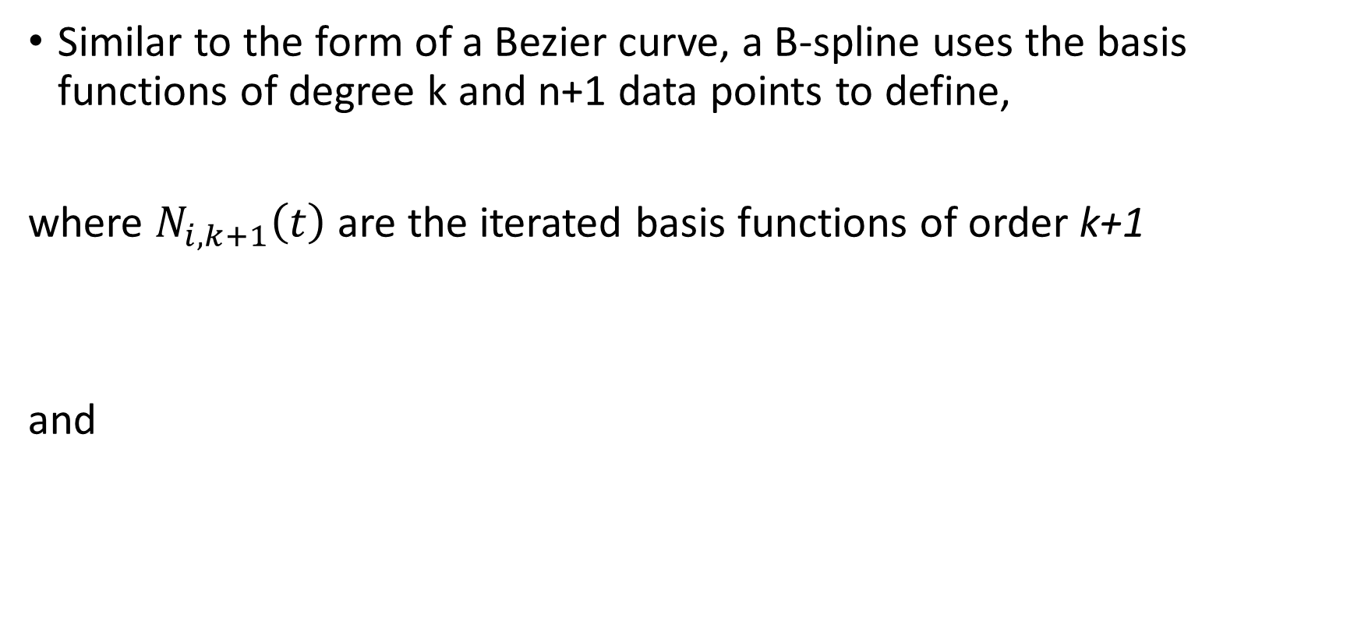
Geometry of curve – B-spline curves
Similar to the form of a Bezier curve, a B-spline uses the basis functions of degree k and n+1 data points to define,
where $N_{i,k+1}\left(t\right)$ are the iterated basis functions of order k+1
and

Slide 56
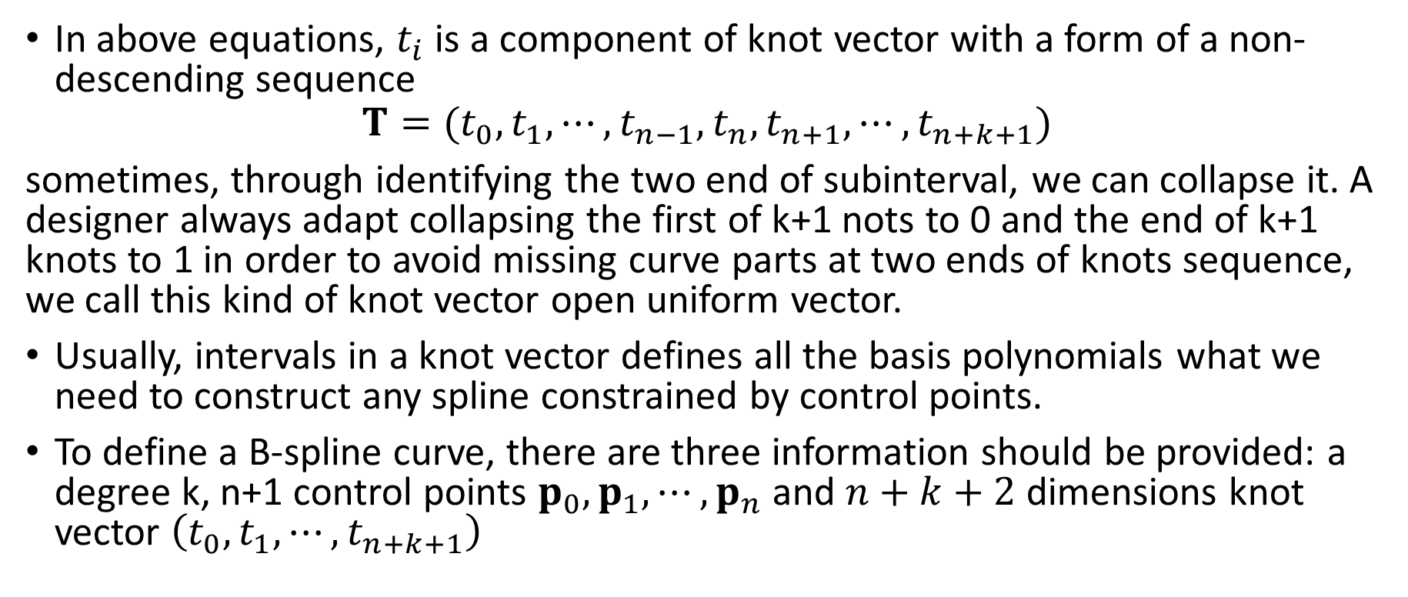
Geometry of curve – B-spline curves
In above equations, $t_{i}$ is a component of knot vector with a form of a non-descending sequence
$$T=(t_{0},t_{1},⋯,t_{n−1},t_{n},t_{n+1},⋯,t_{n+k+1})$$
sometimes, through identifying the two end of subinterval, we can collapse it. A designer always adapt collapsing the first of k+1 nots to 0 and the end of k+1 knots to 1 in order to avoid missing curve parts at two ends of knots sequence, we call this kind of knot vector open uniform vector.
Usually, intervals in a knot vector defines all the basis polynomials what we need to construct any spline constrained by control points.
To define a B-spline curve, there are three information should be provided: a degree k, n+1 control points $p_{0},p_{1},⋯,p_{n}$ and $n+k+2$ dimensions knot vector $\left(t_{0},t_{1},⋯,t_{n+k+1}\right)$

Slide 57
Geometry of curve – B-spline curves
For example, given n=3,k=1, T=(0,0,1/3,2/3,1,1) , we have

Slide 58
Geometry of curve – B-spline curves
p_{i+1}
p_{i-1}
r(u)
p_{i+2}
p_{i}
p_{i-2}
tp_{i}
(1-t)p_{i-1}
0
u_{i-2}
u_{i-1}
u_{i}
u_{i+1}
u_{i+2}
u_{i+3}
u_{i+4}

Slide 59
Geometry of curve – B-spline curves
p_{i+1}
p_{i-1}
p_{i+2}
p_{i}
p_{i-2}
0
u_{i-2}
u_{i-1}
u_{i}
u_{i+1}
u_{i+2}
u_{i+3}
u_{i+4}
Basis functions

Slide 60
Geometry of curve – B-spline curves
Given a knot vector (0,0,0,0,1,2,2,2,2), for 0-degree, there are 8 pieces of basis function. For 1-degree there are 7 pieces of basis function, and for 2-degree there are only 6, and so on.
An order k open uniform B-spline with n+1=k points is the Bezier curve of order k.
For a given degree k, the basis functions are simply shifted versions of one another.
0
0
0
0
1
2
2
2
2

Slide 61
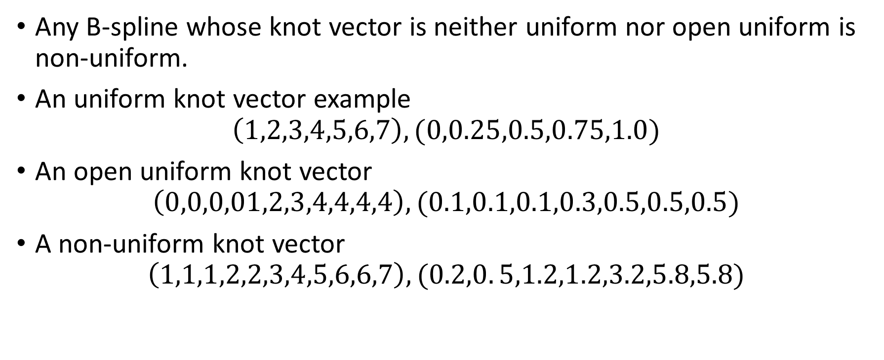
Geometry of curve – NURBS
Any B-spline whose knot vector is neither uniform nor open uniform is non-uniform.
An uniform knot vector example
$$\left(1,2,3,4,5,6,7\right),(0,0.25,0.5,0.75,1.0)$$
An open uniform knot vector
$$\left(0,0,0,01,2,3,4,4,4,4\right),(0.1,0.1,0.1,0.3,0.5,0.5,0.5)$$
A non-uniform knot vector
$$\left(1,1,1,2,2,3,4,5,6,6,7\right),(0.2,0. 5,1.2,1.2,3.2,5.8,5.8)$$

Slide 62
Geometry of curve – NURBS
Any basis function can be represented by algebraic ratio of two polynomials is rational, which has a form like
Based on rational basis functions defined on non-uniform knot vector, we get NURBS. It is short of Non-Uniform Rational Basic Spline.

Slide 63
Geometry of curve – NURBS
NURBS is essentially B-spline in homogeneous coordinates, which is more flexible than B-spline through adding another set of (n+1) weights. Today it is actually an industry standard adopted by most of commercial CAD systems.
NURBS is the general form of the B-spline which incorporate open uniform and uniform B-splines as special cases
Even can be used to approximate a circle with knot vector(0,0,0,1/4,1/4,1/2,1/2,3/4,3/4,1,1,1)
Fig. NURBS approximated circle

Slide 64
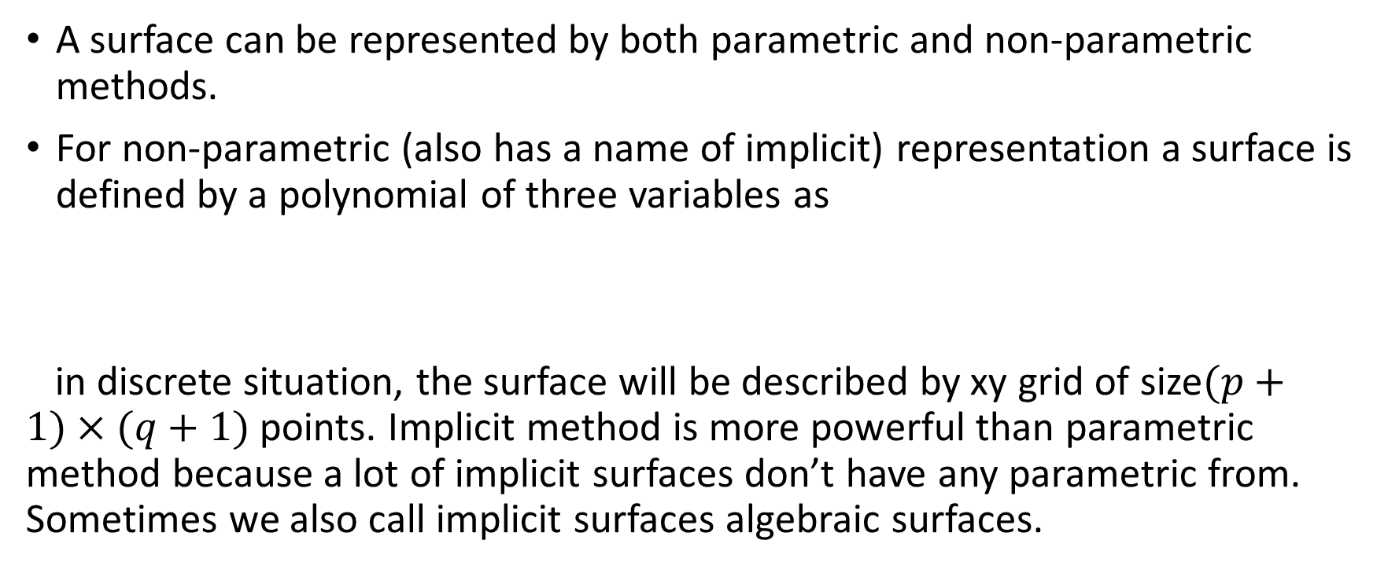
Geometry of surface
A surface can be represented by both parametric and non-parametric methods.
For non-parametric (also has a name of implicit) representation a surface is defined by a polynomial of three variables as
in discrete situation, the surface will be described by xy grid of size$(p+1)×(q+1)$ points. Implicit method is more powerful than parametric method because a lot of implicit surfaces don’t have any parametric from. Sometimes we also call implicit surfaces algebraic surfaces.

Slide 65
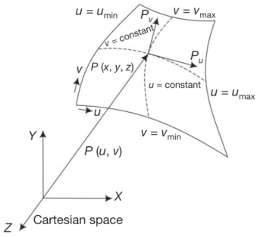
Geometry of surface
For parametric representation, a surface is defined by a set of functions, with the form like
If one parameter is fixed a curve will be got. It means with two spatial curves a surface could be built.

Slide 66
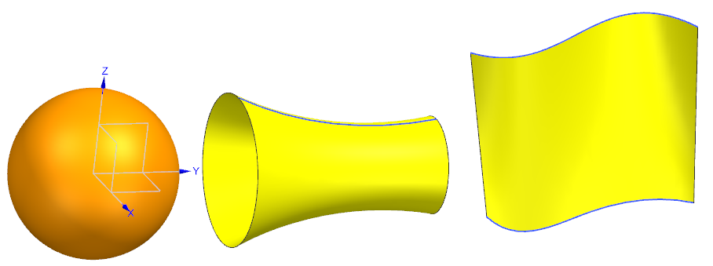
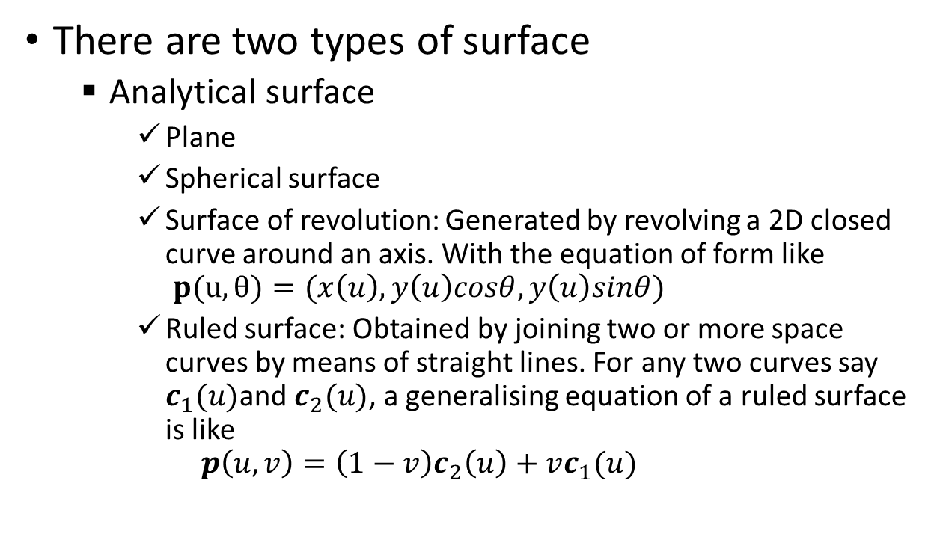
Geometry of surface
There are two types of surface
Analytical surface
Plane
Spherical surface
Surface of revolution: Generated by revolving a 2D closed curve around an axis. With the equation of form like
$$p(u,θ)=(x\left(u\right),y\left(u\right)cosθ,y\left(u\right)sinθ)$$
Ruled surface: Obtained by joining two or more space curves by means of straight lines. For any two curves say $c_{1}(u)$and $c_{2}(u)$, a generalising equation of a ruled surface is like
$$p\left(u,v\right)=\left(1−v\right)c_{2}\left(u\right)+vc_{1}(u)$$

Slide 67
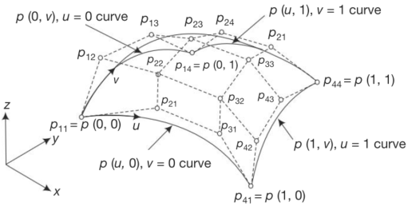
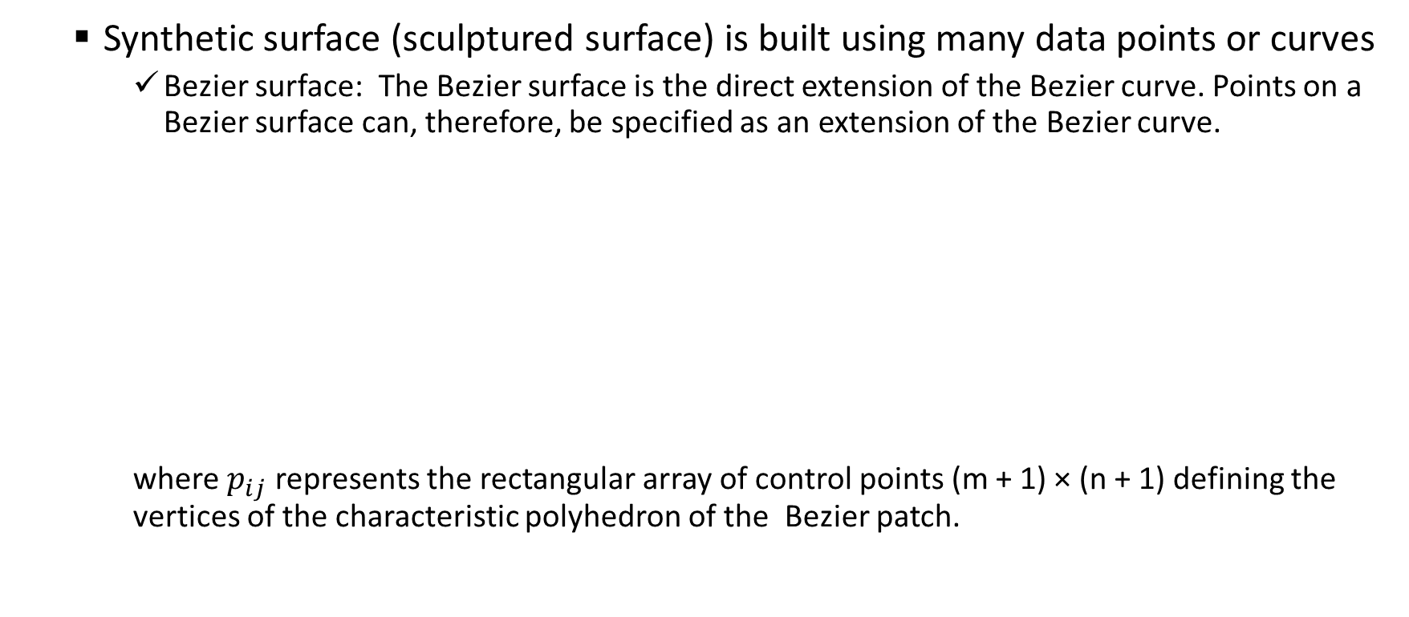
Geometry of surface
Synthetic surface (sculptured surface) is built using many data points or curves
Bezier surface: The Bezier surface is the direct extension of the Bezier curve. Points on a Bezier surface can, therefore, be specified as an extension of the Bezier curve.
where $p_{ij}$ represents the rectangular array of control points (m + 1) × (n + 1) defining the vertices of the characteristic polyhedron of the Bezier patch.

Slide 68
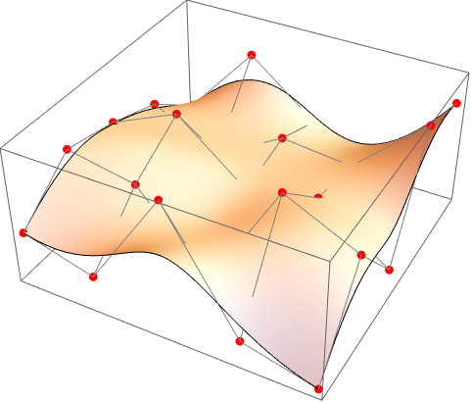
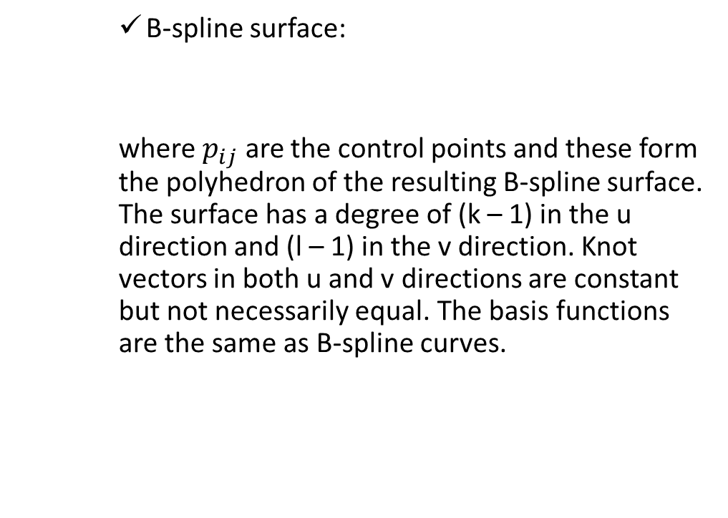
Geometry of surface
B-spline surface:
where $p_{ij}$ are the control points and these form the polyhedron of the resulting B-spline surface. The surface has a degree of (k – 1) in the u direction and (l – 1) in the v direction. Knot vectors in both u and v directions are constant but not necessarily equal. The basis functions are the same as B-spline curves.
https://reference.wolfram.com/language/ref/BSplineSurface.html

Slide 69
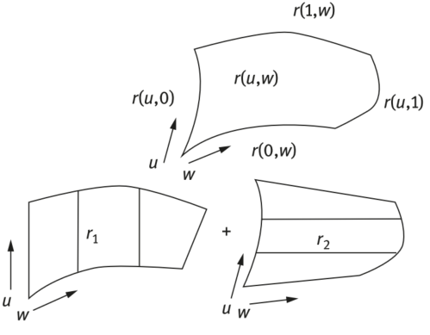
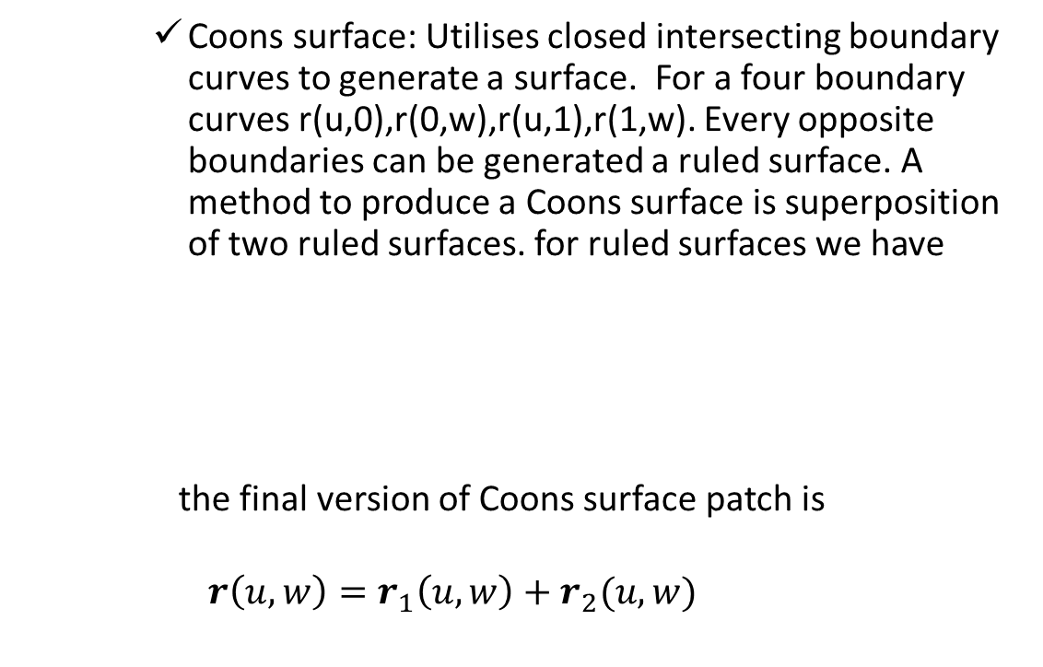
Geometry of surface
Coons surface: Utilises closed intersecting boundary curves to generate a surface. For a four boundary curves r(u,0),r(0,w),r(u,1),r(1,w). Every opposite boundaries can be generated a ruled surface. A method to produce a Coons surface is superposition of two ruled surfaces. for ruled surfaces we have
the final version of Coons surface patch is
$$r\left(u,w\right)=r_{1}\left(u,w\right)+r_{2}(u,w)$$

Slide 70
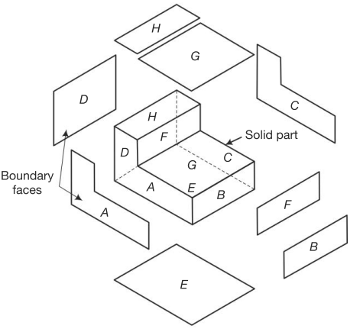


Solid Modelling
The most common methods used in commercial CAD system
Boundary representation (B-Rep)
Constructive Solid Geometry (CSG)
Sweeping

Slide 71
Boundary representation (B-Rep)
Any solid occupies a limited space, that is, it has a boundary wrapped itself. By boundary, it can be clearly distinguished wherever is interior or exterior of the solid. Which means a solid can be defined by its boundary.
Usually, a boundary is geometrically described by its vertices, edges loops, faces, genus and bodies.
There are some data structures with maps have been developed for boundary representations.
Modern systems introduced also quadrics and NURBS surfaces as a part of B-Rep.

Slide 72


Boundary representation (B-Rep)
In a B-Rep model, there are two types of information included, topological and geometric data. The topological part provides the relationships among vertices, edges and faces, etc. Geometric information is usually equations of the edges and faces.
Euler’s law
$$F−E+V−L=2(B−G)$$
where $F,E,V,L,B,G$ are the number of faces, edges, vertices, face’s inner loop, bodies, and genus respectively.
B-Rep of a cylinder
(P N Rao, CAD/CAM: Principles and Applications,3e)

Slide 73
Constructive solid geometry (CSG)
CSG is one of a fundamental theories of varies 3D modelling CAD system.
Boolean operations of multi-bodies
One of ideas in CSG is that some algebraic calculations can be performed between two bodies.
There are three basic Boolean operations of bodies, which are named union, difference and intersect, derived from set theory. However, in Solidworks, they are called add, subtract and common, respectively.
Through Boolean operations one can take uses of several bodies to generate a new body.

Slide 74



Boolean operations in set theory
In set theory, we have
https://en.wikipedia.org/wiki/Venn_diagram

Slide 75

Boolean operations of multi-bodies
Target: The body with the finished geometry is called the target;
Tool: The body used to create or edit the shape is called the tool.

Slide 76

Boolean logic with binary tree
A binary tree structure is usually used to store the basic bodies one lead nodes, the operations on the internal nodes, and the final body on the root node.
https://en.wikipedia.org/wiki/Constructive_solid_geometry

Slide 77


Sweeping
A solid is created by moving a profile shape along a specified path. Most of commercial CAD systems provide the functionality for constructing swept solids in a 2D cross-section moving on a space trajectory.

Slide 78

Geometric modelling technique
There are numerous ways to create computer models using a given geometry. However, geometry and shape of an object have their purpose in a product and it is very helpful for a designer to take design intent into account[2]
Design intent is not just about the size and shape of features, but it can be extended to cover tolerances, manufacturing processes, design constraints, and relationships of features and dimensions[2]

Slide 79
Three methods to create 3D models

Slide 80

Primitive method
In the method, any 3D model was divided into several simple, basic, standard of items, such as blocks, cylinders, spheres, cones, etc. which usually integrated in CAD system as a standard body. Through these, user can decide how to combine different of them together to construct a new model, then using Boolean operations to get the final result.

Slide 81

Fig. Data structure example of a CSG model[2]

Slide 82

Fig. Different solid models from the same set of solid primitives[2]

Slide 83

Feature method
Let user to utilize some predefined feature generating instruments, like groove, hole, slot, boss, pad, etc. to simulate a real manufacturing process to create some structure from a simple basic body.

Slide 84

Sketch method
The main idea of this approach is to create 3D body by 2D sketch. Taking use of extrusion, revolution algorithms, in addition some of basic Boolean operations, use can create a very complex 3D structures.
This method is the most popular way used by most of commercial CAD softwares including Solidworks.

Slide 85
Sketch method
The main steps of sketch method to create 3D models are
Define a sketch plane as cross section;
Sketch 2D shapes on the cross section;
Constraint 2D shapes with accurate dimensions;
Perform 2D to 3D operations.

Slide 86
Kernel features of modelling in Solidworks

Slide 87


Key disciplines of modelling
For basic bodies, generate 3D model by taking use of 2D shapes;
Combine basic bodies to create a complex body;
Repeated bodies can be made through array operations;
Fig. Disciplines of 3D modelling[3]

Slide 88

Coordinate system
Coordinate systems are the most important concept in a CAD system. They are used to input, store, and display geometric model. There are three kinds of coordinate systems, that is, model coordinate system (MCS), working coordinate system (WCS), and screen coordinate system (SCS).
Fig. Coordinate system in Solidworks[3]

Slide 89

Coordinate system
By default, there are already a coordinates system provided for user by SOLIDWORKS every time you open a new modelling project. Usually, at the lower-left corner of the canvas, you can notice the symbol of coordinate system with three axes.
Whenever user need to carry on some location or orientation related modelling steps, the coordination system should be considered.
For example, in the scenarios of re-oriented a model or two models comparing user should define his own reference coordinate systems.
Fig. Three main orthogonal coordinate system[2]

Slide 90



References objects
Reference points
Reference vectors/axes
Reference plane
Fig. Different types of reference object[2]

Slide 91



Sketch
Plane curves
Two types of Constraint
Dimension: length and angle
Relation: parallel, normal, perpendicular, tangent, concentric, etc.
Fig. Relations in sketch[2]
Fig. Fundamental functions of sketch[5]

Slide 92
CAM

Slide 93
NC in CAM
NC is short of Numerical Control.
Basically, a NC machine runs on a program fed to it. The program consists of precise instructions with geometric and process information, such as what tool to be used, at what speed, at what feed and to move from which point to which point in what path.
To make the soft instructions sense, some hard part should be driven
starting and stopping of machine-tool spindle
controlling the spindle speed
positioning the tool tip at desired locations and guiding it along desired paths by automatic control of the motion of slides
controlling the rate of movement of the tool tip
changing of tools in the spindle

Slide 94

Developments of numerical control
The first-generation NC machine tools was developed from MIT in 1952. Bendix Corporation built the first commercial production-based NC unit using MIT patents in 1954. It used only digital electronic circuits and didn’t contain any actual central processing unit.
Fig. Machine tool and controller. (Courtesy of Bridgeport Ma-
chines Division of Textron Inc.)[6]

Slide 95

Developments of numerical control
In the 1970s, computer numerically controlled (CNC) machine tools were developed with minicomputers as control units.
https://www.technews24h.com/2013/07/history-of-computer-numerical-control.html

Slide 96

Developments of numerical control
Today’s CNC systems use high performance microprocessors and programmable logical controllers, which allow simultaneous servoposition and velocity control of all the axis and have capable of an extended range of machining operations, such as machining centres, turning centres, mill-turning centres, CNC grinding, CNC spark erosion etc.
https://www.pinterest.ie/pin/542331980110546672/

Slide 97



Principle of numerical control
The user tells the movement to the machine, from the original position to the desired position.
Then

Slide 98
Principle of numerical control
The basic information that has to be input into the system consists of the part geometry, cutting-process parameters followed by the cutting tools used.
The part program is then entered into the controller of the machine, which in turn runs the machine tool to make the part.
Each of the machine axes is connected to a servomotor/stepmotor which works under the control of the Machine Control Unit (MCU).
The movement of the cutting tool with respect to the workpiece is given in terms of the coordinates, which are used to control the motion of the servomotor/stepmotor which drives the individual axes.

Slide 99


Fig. Numerical control operations[8]

Slide 100
Principle of numerical control
The operate process can be manual or automatic.
Rongshine Lin,Yoram Kore,Real-time Interpolators for Multi-Axis CNC Machine Tools

Slide 101
Main types of CNC machine
Computer Numerical Control (CNC) integrated a computer type controller into the machine tools, which is a big step from NC to CNC. NC focuses mainly on the hardware techniques, and on the other hand, CNC mainly concerns of software techniques, which means more flexibilities, huge data throughput, standard OS. Sometimes it is also termed software numerical control.
There are four numerical control modes:
Point-to-point mode; the machine tool can be moved to any point along X and Y axes, then to perform machining in Z axis at that point, such as drilling machines.
Point-to-point straight line mode; Improved the point-to-point mode, in which the machine tool can carry out a continuous motion in each of the axis direction.
2-axis contouring, with switchable plane; Based on the previous two modes, in this mode, the machine tool can be moved simultaneously in any 2 axes. Based on this mode, the remained one axis can only carry out motion after the 2-axis motion finished, usually we call this situation 2.5D mode.
3-axis contouring continuous path. This mode can be found in most of current-day control systems. In this mode, the machine tool is supposed have the capability of simultaneous 3 or more axes motion.

Slide 102

Main types of CNC machine
Fig. Difference kinds of CNC machine [8]

Slide 103

Main units of a CNC machine tool
A typical CNC machine tool has six main units:
Input device
Machine control unit (MCU)
Machine tool (actuation unit)
Driving system
Feedback devices
Display unit
https://www.mechanicalbooster.com/2017/01/what-is-cnc-machine.html

Slide 104
Structure features of CNC machine
Spindle
Spindle is the most import performing mechanism in a CNC machine-tool
During working, a spindle usually suffers axial and radial forces which transmitted from the machining force. The accuracy of spindle should be taken care of to ensure the proper designed tolerance could be achieved.
The requirements to keep spindle working in a best status
High static and dynamic stiffness
High running accuracy
High axial and radial load carrying capacity
Thermal stability(e.g. introducing temperature compensation system)

Slide 105
Structure features of CNC machine
Drives
Spindle Drives: supply power for spindle to cut.
Dc motor, with infinitely variable speeds controlled by varying the voltage.
Ac motor, controlled by varying the frequency. For positioning the spindle axis, ac drive is a good choice like in turn mill centres.
Feed Drives: supply power for the motion along different axis.
Stepper motor, A type of digital input-output device for precision starting and stopping. It can turn through a fraction of a rotation at a time. Most stepper motors run open-loop, and the faster is turns the less torque it can provide.
Servomotor, A rotary actuator that allows for precise control of angular or linear position, velocity and acceleration. It consists of a suitable motor coupled to a sensor for position feedback. It always works under a closed-loop control mode.
Linear motor, A recently developed drive, which works with very high speed and acceleration and very fast response.

Slide 106


Structure features of CNC machine
Actuation Systems
Lead Screws: a set of mechanism converts a rotary motion from the drive motor to a linear motion in a fast speed and very low friction.
Linear-Motion Systems : used to control the direction of a translational movement of the table on which the tools or works are held. The shape and size of the work produced depends not only on the accuracy of the amount of movement, but also on the direction of the relative movement of the tool and the work.

Slide 107


Structure features of CNC machine
Feedback Devices
Optical Rotary Encoder: converts the rotary motion into a sequence of digital pulses. The pulses are counted to convert to either absolute or incremental position measurement.
Linear Scale: detect a distance to get the exact position of the detecting target. Sometimes, a Moire fringe pattern will be used to magnify a very small distance.

Slide 108


Axes and motion of a CNC machine
Coordinate system of CNC machine tools
ISO/R841 is one of popular standards followed by most of CNC machine vendors.
Right hand Cartesian coordinate system
Using right hand rule to find the directions of axes and the positive direction for rotary motions.
Usually, in order to create a coordinates the Z axis should be defined first.

Slide 109
Axes and motion of a CNC machine
Z Axis and Motion Direction
The definition of Z axis depends on three cases:
In the general case of machine with spindle, the Z axis motion will be defined alone the spindle axis and the positive Z direction is letting the tool moving away cutting surface. (which means when the drill tool drilling into a workpiece, it is moving in the negative Z direction)
In the case of machine without spindle, the Z axis motion will be defined alone the line perpendicular to the work-holding plane. And the direction is same as the first situation.
If there is a machine with several spindles, the Z axis motion will be the same as the principal spindle which usually be identified as the one perpendicular to the work-holding surface. Meanwhile the tool motions alone the other spindles are called as secondary or tertiary motions, which can be marked as U, V, W or P, Q, R.

Slide 110
Axes and motion of a CNC machine
X Axis and Motion Direction
The X axis will be chosen to perpendicular to the Z axis which is already well defined, and to be usually horizontal and to put into the positioning plane of the cutting tool or the workpiece.
The direction of the X axis motion is always to the right if looking from the principal spindle to the column.
Y Axis and Motion Direction
After you have got the detail of the Z and X axis, by using right hand rule people can find easily the proper Y axis and its positive direction because these three axes form a complete right-hand Cartesian system.

Slide 111

Axes and motion of a CNC machine
Rotary Motions A, B and C
Usually, the rotary motions with the axes X, Y and Z are termed as A, B and C respectively.
Positive directions of A, B and C are in the directions which satisfy right-hand rule in the positive directions of X, Y and Z.
Fig. Primary, secondary and tertiary axes[7]

Slide 112

Axes and motion of a CNC machine
Some examples of different axes CNC machines
Three-axes CNC machine
Four-axes CNC machine
Five-axes CNC machine

Slide 113




CNC Tooling Systems
A tooling system define a set of configurations to mount, locate cutting tools securely in position.
A typical tooling system should meet some requirements as follows:
Easily manipulated by a tool changing mechanism
Keep repeatability within tolerance of a tool
Fast and easy tool assembly
Most of configurations of them are following ISO standard. Statistically, the 20-30% of total budget was spent on tooling for a NC machine tools. It is always a key to get the exactly position of a tool tip at any time in any machining process.
Flanges
Collets
Fig. Tooling system for a machining centre[7]
Origin: https://en.nttool.com/products/nc/

Slide 114
Cutting Tool for CNC Machine Tools
Features a cutting tool must have
Hot hardness: must maintain its strength and hardness during cutting processing even experience in high temperature situation.
Toughness: can not be made broken or crack when cutting status changing suddenly.
Wear resistance: a relative longer life before be replaced

Slide 115
Cutting Tool for CNC Machine Tools
Commonly used cutting tool materials
High speed steel (HSS): is a complex carbides of tungsten, molybdenum and chromium, which has the highest toughness, high hot hardness and good wear resistance
Cemented carbides: produced by the cold compaction of the tungsten carbide powder in a binder. when coated they get superior properties.
Ceramics: are essentially alumina-based high refractory materials, which has highest wear resistance but low toughness.
Diamond: is essential pure carbon with two types: industrial grade natural diamonds and synthetic polycrystalline diamonds.
Cubic boron nitride (CBN): similar to diamond, also has polycrystalline structure bonded to a carbide base.

Slide 116
Cutting Tool for CNC Machine Tools
Commonly used cutting tool materials
Tool material | Suitable working materials and conditions
Carbon steels | Low strength, softer materials, nonferrous alloys, plastics with low cutting speeds
High-speed steel | All materials of low and medium strength and hardness. Can not be used at high rate of metal removal
Cemented carbide | All materials up to medium strength and hardness. Not suitable for low-speed application
Ceramics | Cast iron, Ni-base super alloys, nonferrous alloy, plastics. Not suitable for low speed operation or interrupted cutting
Diamonds | Can only be used on nonferrous metals because carbon has an strong affinity with ferrous metals.
CBN | Only be used in some extreme cutting conditions

Slide 117
Comprises of a CNC system
Based on this structure, there are serval commercial systems working on the different CNC machine tools all over the world. Systems developed by Fanuc and Siemens are most famous two.

Slide 118

Machining from 3D models.
The CNC system based on the traditional architecture and its data flows
Chen Mo. A NEW TYPE OF CNC SYSTEM AND ITS INTERPOLATOR BASED ON DIGITIZER/PLAYER ARCHITECTURE. Shanghai Jiao Tong University.2016

Slide 119
Machining from 3D models
The process of open-loop motion.

Slide 120
Machining from 3D models
The process of closed-loop motion.

Slide 121

CNC control systems
Fanuc CNC Series (30i like…)
Very popular control systems developed by FANUC and GE Fanuc Automation
Multiple axes (up to 40 axes and 24 of which can be interpolated simultaneously) and multipath (up to 10 paths) support, such as
Multi-axis lathes
5-axis machining centers
Gear cutting machines
Transfer machines
Integrated PLC/PMC(Programmable Machine Control)
Easy to create HMI screen

Slide 122

CNC control system
Siemens Sinumerik series (SINUMERIK 840 like)
Drive-based high-performance NCUs (Numerical Control Units),
Up to 93 axes in 30 machining channels to be controlled in the NCU link
Can be integrated completely in the Totally Integrated Automation (TIA) Portal using PROFINET.
Suitable for turning, milling, grinding, nibbling, laser machining and gear wheel machining.
DXF files can be directly opened on the CNC, and transferred to the CNC program.
Tool geometries and work offsets are corrected automatically so that the required production tolerances are maintained.
Tool data and magazine location information are clearly stored.

Slide 123


Introduction to CAPP
Three important process parameters
Cutting velocity/speed: the kernel parameter in three, it is a relative speed difference between the tool and workpiece, which defines the main cutting motion.
Feed rate: usually perpendicular to the direction of cutting velocity. It helps cutting tool to form a 2D surface of material.
Depth of cut: specifies the thickness of the surface above mentioned, which finished the total volume definition of material cut.

Slide 124
Introduction to CAPP
Three important process parameters
All those three parameters defined well how much material will be removed by cutting tool in an unit period of time, which is usually named the metal removal rate.
Usually, cutting speeds are selected for a specified tool life. Higher the cutting speed, shorter will be the life of the tool.
A high depth of cut will result in higher metal removal rate and less time for machining, resulting in low machining cost.
Higher feed will also reduce machining time and therefore, machining cost. However, the increase in feed will affect the tool life more than increasing depth of cut.
It is advisable to select a higher depth of cut and smaller feed for the same chip cross-section. In finishing it is necessary to select small depth of cut and feed.

Slide 125

Introduction to CAPP
Principles for process design
What a process design concerns is how to change a piece of designed drawing on paper or in a computer into a real physical entity. To do this, there are bunch of things a process designer should take into account. Like
Analysis of part requirements.
Selection of raw workpiece/material.
Determination of manufacturing operations and their sequences.
Selection of machine tools.
Selection of tools, work-holding devices and inspection equipment.
Determination of machining conditions (cutting speed, feed and depth of cut) and manufacturing times (setup time, processing time and lead time).
Fig. Activities in a process planning system[7]

Slide 126
Introduction to CAPP
Principles for process design
The above-mentioned steps are not always performed sequentially, they are inter-connected.
Even for the same model, there could be several methods to produce it. Each of which spends different time and cost. And the quality, accuracy, and productivity heavily depend on the process performed.
Usually, a well designed process refers to a set of instructions that translate design specifications into manufacturing process details. If all the process was followed, a design specifications will be met.

Slide 127
Introduction to CAPP
Computer-Aided Process Planning
Definition
Traditionally, process planning is performed manually by highly experienced planners who possess in-depth knowledge of the manufacturing processes involved and the capabilities of the shop-floor facilities.
Computer Aided Process Planning ( CAPP) is a means to automatically develop the process plan from the geometric image of the component. The key to development of such CAPP Systems is to structure the data concerning part design, manufacturing facilities and capabilities into categories and logical relationships.
CAPP appears to fully integrate CAD and CAM

Slide 128

Introduction to CAPP

Slide 129
Introduction to CAPP
Computer-Aided Process Planning
Variant Method
Search for a generic process plan from the existing master process plans developed for each part family and edits to suit the requirement of the part. The variant Method is commonly implemented with Group Technology (GT) coding system. Here, the parts are segmented into groups based on similarity and each group has a master plan.
Four-step process
define the coding scheme;
group the parts into part families;
develop a standard process plan;
retrieve and modify the standard plan.

Slide 130


Introduction to CAPP
Fig. Rotational part family requiring similar turning operations[7]

Slide 131

Introduction to CAPP
Computer-Aided Process Planning
Generative Method
Process plans are generated by means of decision logic, formulas, technology algorithms and geometry-based data to uniquely perform processing
decisions. The knowledge-based CAPP system is most commonly used. It refers to a computer program that can store knowledge of a particular domain and use that knowledge to solve problems from that domain in an intelligent way. In such a system, computers are used to simulate the decision process of a human expert.
There are two major problems to be solved: knowledge representation and inference mechanism.

Slide 132
Computer-Aided Process Planning
Trajectory Generation
Tool path generation for freeform surface is probably the most complex step in machining process. The surface is usually defined by an optical equation. This equation must be specified as a function in cylindrical coordinates Z = function (r, phi) where r is the radius or the machines x-axis and phi is the work spindle angle or c-axis position. Therefore, equations defined in Cartesian coordinates as Z = function (X, Y) need to be converted to cylindrical coordinates.

Slide 133
Computer-Aided Process Planning
Trajectory Generation
There are multiple ways to create the r and phi points before solving for z. The c points or phi can be made from equally spaced chords or equally spaced angles. Usually equally spaced angles yield better results. After the r and phi points are determined they are used to solve the function for each of the z points. The next step in tool path generation is the tool radius compensation. The surface slopes of the non-rotationally symmetric surfaces are not only dependent on changes in the radius r but also on changes in the angle phi. Slope calculations are required at every z point. The slopes can be computed using two methods; the first method is the differentiation of the data points and the second method is the differentiation of the equation, Z = function (r, phi). The equation differentiation has been proven to be the more accurate solution, however it is the more difficult one to compute. If the optical surface is generated using NURBS the tool path is better computed using an off the shelf CAM (Computer Aided Manufacturing) software.

Slide 134
Computer-Aided Process Planning
Trajectory Generation
CAM systems usually don’t provide the same level of accuracy as obtained by solving an optical design equation, because they try to fit non-uniform splines to the surfaces and there are errors associated with these fitting functions. Once the z, x, and phi data points are generated they are written to the NC file (The machine input file). The NC file is then executed. Unlike regular machining it is been found that to produce more accurate parts it is better to machine the part in inverse time G93 rather than mm/min G94. The reason behind this is inverse time allows the program to run with a variable velocity or axis feed rather than a fixed velocity. This variable velocity programming generates more accurate sine waves, while fixed velocity distorts the sine waves the machine is trying to perform.

Slide 135

Computer-Aided Process Planning
Trajectory Generation
All units are converted into counts

Slide 136
Programming for CNC machining
Coordinate systems and Program Zero of CNC
The machine tools are programmed in a Cartesian coordinate system. Usually, the Z axis is aligned with the direction of spindle. The primary X motion is normally parallel to the longest dimension of the primary machine tool table. The Y axis is normally parallel to the shortest dimension of the primary machine tool table. Characters A, B, and C designate angular motions around the X, Y, and Z axes, respectively. A programmer can always assume that the tool moves relative to the coordinate system of the stationary workpiece.
The origin point for each axis is commonly called the program zero point, which allows the programmer to input all coordinates within a program from a common and logical point. Under the limitation of a CNC , a program zero can be set at any point for convenience where in order to make the program code much easier. In most of situations, locating the program zero point on the workpiece from which the most dimensions are taken.

Slide 137

Programming for CNC machining
Main steps doing CNC programming
Study of production drawing and other documents prepared by planning department
Determination of stock size
Study of machine tool specifications and features of control system
Sequencing machining processes in an optimum manner
Deciding the setups
Tool selection
Selection of technological parameters like speed, feed, etc.
Tool path determination
Preparation of working sketches and calculations, if needed
Program preparation (manually or by computer)
Program transfer to the CNC
Tool path simulation/program simulation
Program testing—dry run, and debugging
Manufacture of components
Documentation for future reference

Slide 138
Programming for CNC machining
The structure of part programs.
The CNC data sequence convention is:
N G XYZAB F S T M eob
Sequence Number: identifier N, it is used to identify each particular block of information.
Preparatory function: identifier G, It is a pre-set function associated with the movement of machine axes.
Dimensional data :identifier X,YXZ,A or B, location and axis orientation data for a cutter move
Feed functions: identifier F, it is the feed rate, and the units are either mm/min or mm/rev.
Spindle functions: identifier S, spindle speed or parameters for constant surface speed operation
Tool functions: identifier T, specify the cutter and its offsets
Miscellaneous functions: identifier M, perform a variety of auxiliary commands(usually the ON/OFF codes which control the machine tool)
End of block (eob) character

Slide 139


Programming for CNC machining
Other codes
I J K: Coordinates of the centre of a circle.
R: The radius of a circle.
UVW: The incremental dimensional data of XYZ.
D,H,K,P,Q etc., determining the meaning according to the specific code

Slide 140
Programming for CNC machining
An NC part program represents the machining sequences, or blocks, used to produce a desired component shape. Each block starts with the letter N followed by the block sequence number. One block of a typical NC program would look like
N0040 G91 X25.00 Y10.00 Z−12.55 F150 S1100 T06 M03 M07
The NC program consists of blocks, and each block consists of several words. A word starts with a character followed by numbers that represent a speciﬁc command for the machine tool.

Slide 141
Programming for CNC machining
Basically, Most of NC words and their functions follows ISO 1056 international standards.
The word starting with G represents the preparatory functions, and the M words are the miscellaneous functions in the NC program. The words starting with F and S represent the feed and spindle speeds, respectively. T represents the tool number. x, y, and z letters followed by the scalars represent the motion lengths in the designated axes.

Slide 142
Programming for CNC machining
Based on this, the red NC block given above is interpreted as follows by the CNC executive software:
Load tool number 6 on the spindle (T06).
rotate the spindle CW at 1100 rev/min (S1100,M03) and turn the cutting ﬂuid on (M07) before the motion starts.
Move the machine tool in 25mm, 10mm, and 12.55mm increments (G91) in the x, y, and z directions with the resultant feeding velocity of 150 mm/min along the tool path.
N040 represents the 40th block sequence of the entire part program.

Slide 143
Programming for CNC machining
Commonly used NC words are as follows:
NC word | Description | NC word | Description
N | Block sequence number | C | Angular dimension about Z axis
G | Preparatory function | I | Interpolation parameter or thread lead parallel to X
X | Primary X motion dimension | J | Interpolation parameter or thread lead parallel to Y
Y | Primary Y motion dimension | K | Interpolation parameter or thread lead parallel to Z
Z | Primary Z motion dimension | F | Feed word
U | Secondary motion parallel to X axis | M | Miscellaneous function
V | Secondary motion parallel to Y axis | S | Spindle speed word
W | Secondary motion parallel to Z axis | T | Tool number word
A | Angular dimension about X axis | R | Rapid traverse dimension in Z axis
B | Angular dimension about Y axis

Slide 144
Programming for CNC machining
Some commonly used CNC Functions (for Fanuc system)
Preparatory Commands (G-codes) |  | Miscellaneous Commands (M-codes)
G00 | Point-to-point positioning | M00 | Program stop
G01 | Linear interpolation | M01 | Optional stop
G02 | Clockwise circular interpolation | M02 | End of program
G03 | Counter-clockwise circular interpolation | M03 | Spindle start clockwise
G04 | Dwell | M04 | Spindle start counter-clockwise
G05 | High-precision contour control | M05 | Spindle stop
G06 | NURBS machining | M06 | Tool change
G40 | Cancel tool nose radius compensation | M07 | Mist coolant on
G41 | Tool nose radius compensation – left | M08 | Flood coolant on
G42 | Tool nose radius compensation – right | M09 | Coolant off
G43 | Cutter length compensation | M10 | Clamp
G44 | Cancel cutter length compensation | M11 | Unclamp
G70 | Dimensions in inches | M13 | Spindle clockwise, coolant on
G71 | Metric dimensions | M14 | Spindle counter-clockwise, coolant on
G90 | Absolute dimensions | M30 | End of tape, rewind
G91 | Incremental dimensions
G92 | Datum offset

Slide 145
Programming for CNC machining
CNC operations
Absolute programming:
absolute coordinates are given in the machine’s coordinate space
the origin may be redefined
Incremental programming:
each move is specified as an increment from the previous position
the encoders must be moved to a known position at start-up

Slide 146

Programming for CNC
CNC operations
Cutter compensation (Tool Nose Radius Compensation):
most tools cut on a curved edge rather than single point
the cutter path must be offset by the tool radius; the path defines the tool side of profile
using a different tool should not affect the program
Constant surface speed (CSS)
this automatically adjusts the spindle speed to maintain the cutter speed with respect to workpiece

Slide 147
Programming for CNC machining
An example of FANUC system programming.
N10 G54 G90 G49 G80;
N20 M06 T01;
N30 S1000 M03;
N40 G00 X0.0 Y0.0 M08;
N50 Z20.;
N60 G01 Z-6.F100.;
N70 X10. Y10.;
N80 G00 Z100.;
N90 M09;
N95 M02;
Programming in absolute coordinates, initialization;
Change 1# tool;
Start the spindle and the speed is 1000rpm, Spindle clockwise rotation;
Linear interpolation at high speed to X0,Y0, coolant 1 on;
Linear interpolation at high speed to Z20;
Linear interpolation at 100 feed rate to Z-6;
Linear interpolation at 100 feed rate to X10,Y10;
Linear interpolation at high speed to Z100;
Coolant off;
End of program;

Slide 148
Machining from 3D models
What is happening from a 3D model to final physical part

Slide 149
Machining from 3D models
Machine tool has the positioning systems.
Absolute coordinate system:
A (0,3) B (3,4)
C (5,2) D (3,-2)
E (0,-4) F (-3,-2)
G (-5,2) H (-3,4)
Incremental coordinate system:
A (0,3) B (3,1)
C (2,-2) D (-2,-4)
E (-3,-2) F (3,-2)
G (-2,4) H (2,2)
A (3,-1)

Slide 150
Machining from 3D models
Interpolation
Interpolation, which is necessary for any type of programming, consists of generating data points between given coordinate axis positions. Within the Machine Control Unit (MCU), a device called an interpolator causes the drives to move simultaneously from the start to the end of the command.
https://www.globalspec.com/reference/56243/203279/section-5-interpolation

Slide 151
Machining from 3D models
Interpolation
The interpolator is either an electronic hardware device for a NC system, or a software program for a CNC system. An interpolator provides two functions:
It calculates individual axis velocities to drive the tool along the programmed path at the given feed rate.
It generates thousands of intermediate coordinate points along the programmed path between the start point and the end point of the cut.
https://www.globalspec.com/reference/56243/203279/section-5-interpolation

Slide 152
Machining from 3D models
Interpolation
Reference Pulse Method: the computer generates a sequence of output pulses for each axis-of-motion, each pulse generating a motion of one BLU(Basic length-unit). The accumulated number of pulses represent position, and the pulse frequency is proportional to the axis velocity.
Sampled Data Method:
https://www.globalspec.com/reference/56243/203279/section-5-interpolation
Linguo YANG,etc.Research and Development of Sampled-data Interpolation Algorithm Software in CNC System Based on the Visual C++ , Materials Science and Engineering 382 (2018) 042019 doi:10.1088/1757-899X/382/4/042019

Slide 153
Machining from 3D models
Linear interpolation
DDA Line Drawing Algorithm
DDA stands for Digital Differential Analyzer. This is an incremental line algorithm, the calculation of each step is based on the results of the previous steps.
The line equation:
y = mx + c
m = slope
c = intercept
https://medium.com/geekculture/dda-line-drawing-algorithm-be9f069921cf

Slide 154

Machining from 3D models
Linear interpolation
DDA stands for Digital Differential Analyzer. This is an incremental line algorithm, the calculation of each step is based on the results of the previous steps.
(X1, Y1) is the initiao point, and (X2, Y2) is the end point.
Case 1: When |m|<1
Assume and X1 < X2
Start with,
X = X1, Y = Y1,
The slope of the line can be determined using,
In this case, we always keep the difference in X coordinate values to 1.

Slide 155


Machining from 3D models
Linear interpolation
So we can simply calculate the next Y coordinate value by adding slope to the current y coordinate.
Continue until X = X2
Case 2: When |m|>1
Start with,
X = X1, Y = Y1,
But instead of X, we increment the Y value by one.
So, when we assign this to the slope equation, we can get the current X value.
Continue until Y = Y2

Slide 156

Machining from 3D models
Example
Draw a line from (2, 1) to (8, 5)
X1 = 2, X2 = 8, Y1 = 1 and Y2 = 5
First, calculate the slope of the line.
The slope is less than 1.
Increment X values by one, and add slope to get the corresponding Y value. Finally round off the Y values.

Slide 157
Machining from 3D models
Example
Draw a line from (2, 1) to (8, 5)
X | Y | Round off Y | Endpoint Judge | Coordinate (X_{i}, Y_{i})
2 | 1 | 1 | X₀< 8 | 2,1
3 | 1.6667 | 2 | X₁< 8 | 3,2
4 | 2.3333 | 2 | X₂< 8 | 4,2
5 | 3 | 3 | X₃< 8 | 5,3
6 | 3.6667 | 4 | X₄< 8 | 6,4
7 | 4.3333 | 4 | X₅< 8 | 7,4
8 | 5 | 5 | X₆= 8 | 8,5

Slide 158

Machining from 3D models
Circular interpolation
Rough interpolation and fine interpolation of the Sampled Data Method
Reference Pulse Method
Circular arc interpolation by the Reference Pulse Method
http://www.helmancnc.com/circular-interpolation-concepts-programming-part-1/

Slide 159

Machining from 3D models
Sampled Data Method
Rough interpolation and fine interpolation of the Sampled Data Method
Lu Lei.Research on the feedrate scheduling and interpolation method of the freeform machining .Jilin University

Slide 160
Material handling in CAM environment
Logistic and storage system
AGVS
AS/RS
Swarf handling and disposal of wastes
Assembly lines
Quantitative analysis of assembly systems.

Slide 161
Key disciplines of manufacturing under Solidworks environment
Configuration for a mill or turn machine
Features to machining strategy
Generate operation plan
Generate tool path
Simulation
Post process

Slide 162
The following slides are only for learning purpose

Slide 163
Go to the Solidworks CAM module(just perform each of tool button alone the toolbar from left to right, one can finally get the tool path and G-codes)
Define machine
Setup coordinate system
Define stock size using stock manager

Slide 164
Using setup->mill setup to tell the machine which direction is the machining (removing material) direction.
Extract machinable features(which features will be removed)
Generate operation plan(usually have cutting times for the same surface)
Adjust the plan by removing part of operations or changing some parameters for cutting
How to decide the basic cutting parameters(F/S):
Cutting and spindle speed calculations

Slide 165
Feed rate calculatons
Ususlly, we have general start conditons, in which
For HSS(high speed steel tool)

Slide 166
For Carbide
Depth of cut is approximately 10% the diameter of the tool, except with face mills:0.005 inch max. (SFPM=surface feet per minute)
Decide roughing

Slide 167
References
[1] Ibrahim Zeid. Mastering CAD/CAM. McGraw-Hill Higher Education. 2004
[2] Zhuming Bi, Xiaoqin Wang. Computer Aided Design and Manufacturing. John Wiley & Sons Ltd and ASME Press. 2020
[3] https://www.cati.com/blog/solidworks-use-3dquicktools-sketch-tools/
[4] JOHN F. HUGHES, etc. Computer Graphics Principles and Practice 3rd Edition. Pearson Education, Inc. 2014.
[5] Solversoft Corporation. INTRODUCING SOLIDWORKS. Dassault Systemes SolidWorks Corporation. 2019
[6] MIKELL P. GROOVER, etc. CAD/CAM: Computer-Aided Design and Manufacturing. PTR Prentice Hall Prentice-Hall, Inc. 1984
[7]Xun Xu. Integrating advanced computer-aided design, manufacturing, and numerical control : principles and implementations. IGI Global. 2009

Slide 168
References
[8]P N Rao. CAD/CAM: Principles and Applications, 3rd Edition. Tata McGraw Hill Education Private Limited. 2010
P Radhankrishnan. Computer Numerical Control Machines and Computer Aided Manufacture, 2nd Edition. New Academic Science Limited. 2015
Yusuf Altintas. Manufacturing Automation, 2nd Edition. Cambridge University Press. 2012
Xun Xu. Integrating Advanced Computer-Aided Design, Manufacturing, and Numerical Control: Principles and Implementations. IGI Global. 2009
Jianbin Xue. Integration of CAD/CAPP/CAM. Science Press Beijing. 2018

